Slide 1
Chapter-6: IIR ( Infinite Impulse Response ) Filter Design
Introduction:
In the design of frequency-selective filters, the desired filter characteristics are specified in the frequency domain in terms of the desired magnitude and phase response of the filter.
To develop a digital filter, we determine the coefficients of a causal FIR or IIR filter that closely approximates the desired frequency response specifications.
The design of discrete-time (digital) filters corresponds to determining the parameters of a transfer function or difference equation that approximates a desired impulse response or frequency response within specified tolerances.
There are two types of digital filters:
IIR filters
FIR filters

Slide 2
Selection of the Filter Types:
The selection of FIR or IIR, depends on the nature of the problem and on the specifications of the desired frequency response.
An FIR filter is preferred when there is a requirement for a linear-phase characteristic within the passband of the filter.
If there is no requirement for a linear-phase characteristic, either an IIR or an FIR filter may be employed.
An IIR filter has lower number of sidelobes in the stopband than an FIR filter. For this reason, if some phase distortion is either tolerable or unimportant, an IIR filter is preferred because its implementation involves fewer parameters, requires less memory and has lower computational complexity.

Slide 3
Note:
In digital filter design, frequency transformations are described in both the analog and digital domains for transforming a lowpass prototype filter into either another low pass, bandpass, bandstop, or highpass filter.
In the design of IIR filters, only the desired magnitude response is specified and the phase response obtained from the design methodology is accepted.
Advantages and Disadvantages of Digital Filters:
Advantages:
Digital filters are flexible, portable, accurate than analog filters.
Thermal stability to compensate fo element value changes. ( temperature, humidity etc.)
Precision to enhance filter performance.
Adaptability to changes in frequency response.
Multiplexing to match input bit rate.

Slide 4
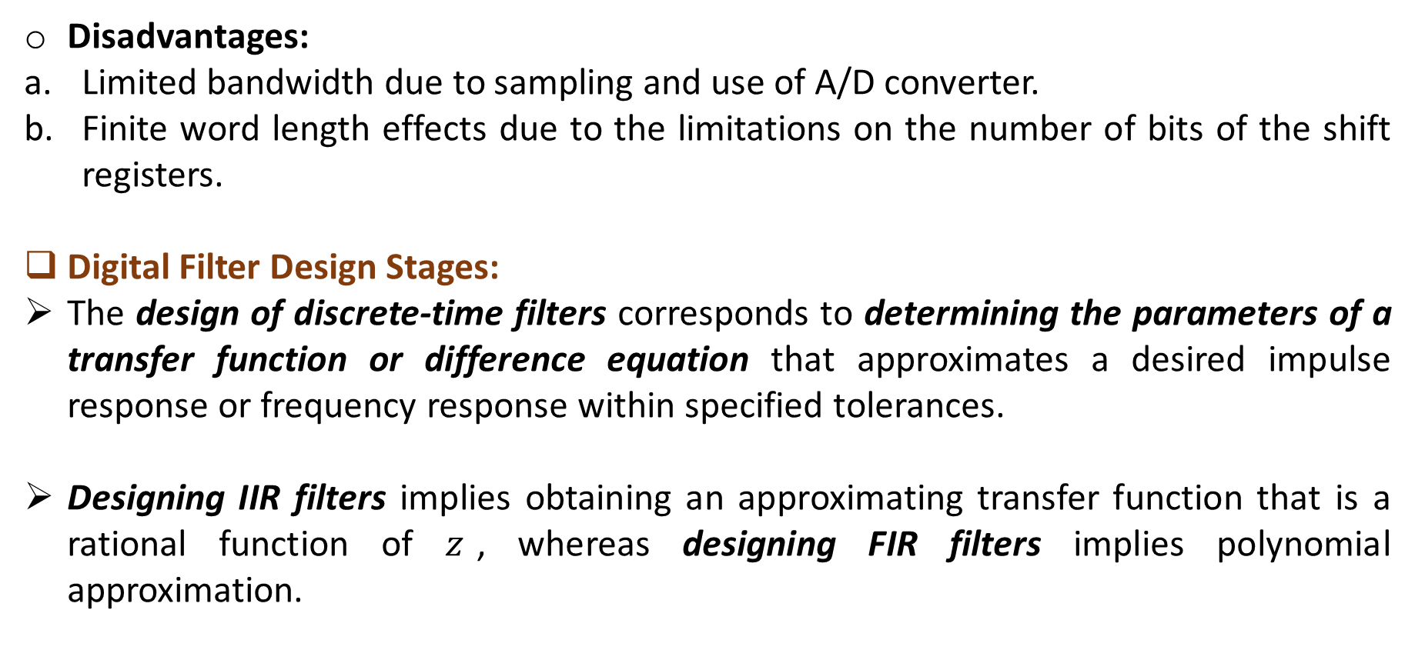
Disadvantages:
Limited bandwidth due to sampling and use of A/D converter.
Finite word length effects due to the limitations on the number of bits of the shift registers.
Digital Filter Design Stages:
The design of discrete-time filters corresponds to determining the parameters of a transfer function or difference equation that approximates a desired impulse response or frequency response within specified tolerances.
Designing IIR filters implies obtaining an approximating transfer function that is a rational function of $z$, whereas designing FIR filters implies polynomial approximation.

Slide 5
The design of filters involves the following stages:
Determine the specification of the desired properties of the system,
The approximation of the specifications using (designing) a causal discrete-time system, and
The realization of the system.
Specifications are typically given in the frequency domain.
Although these three steps are certainly not independent, we focus our attention primarily on the second step, the first being highly dependent on the application and the third dependent on the technology to be used for the implementation.

Slide 6
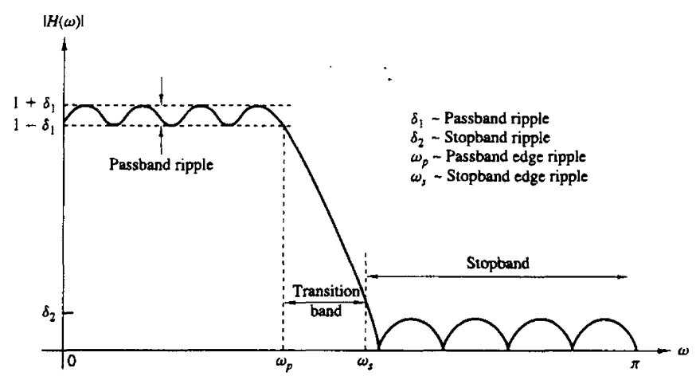
Characteristics of Practical Frequency-Selective Filters (Practical Filter Specifications):
$$or \left|{H(e}^{jω})\right|$$

Slide 7
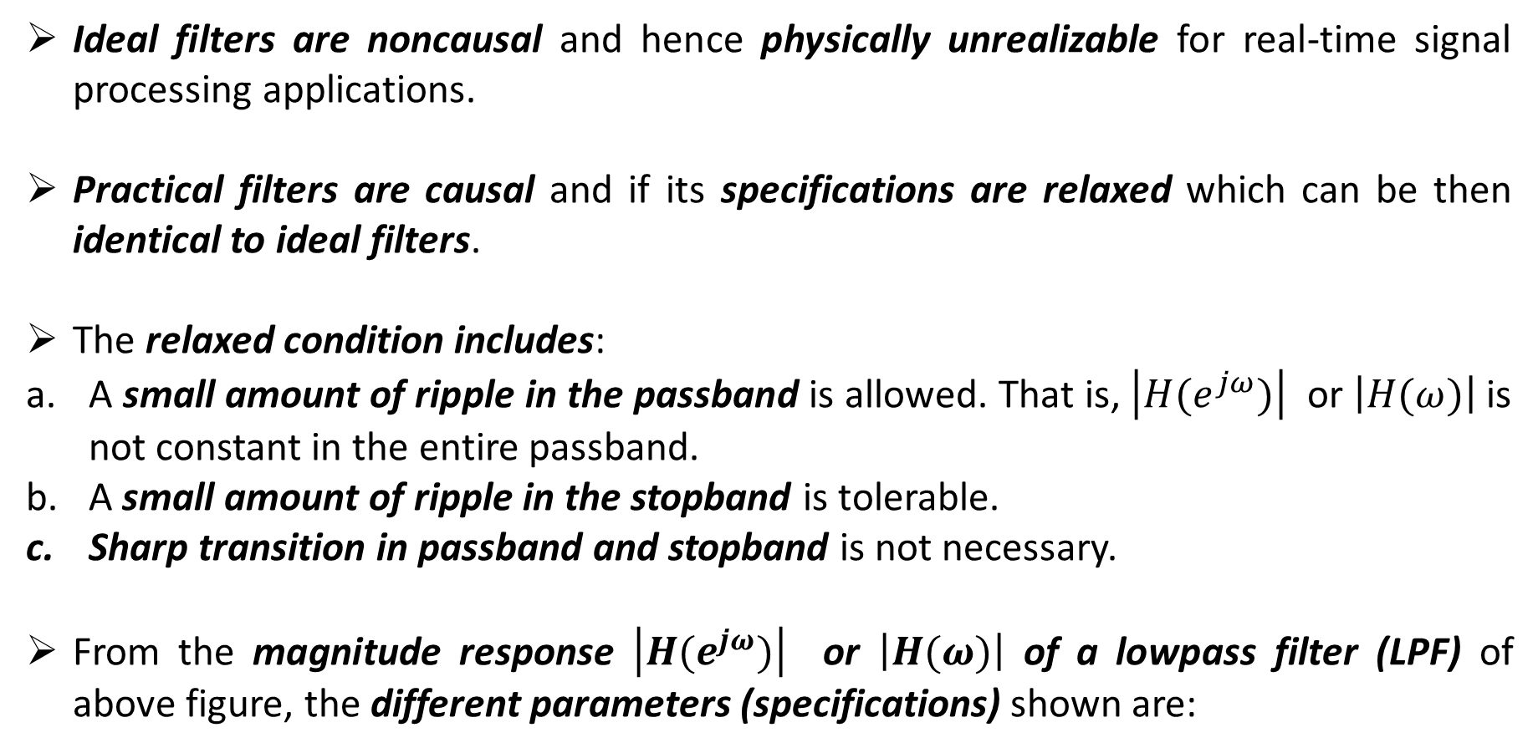
Ideal filters are noncausal and hence physically unrealizable for real-time signal processing applications.
Practical filters are causal and if its specifications are relaxed which can be then identical to ideal filters.
The relaxed condition includes:
A small amount of ripple in the passband is allowed. That is, $\left|{H(e}^{jω})\right|$ or $\left|H(ω)\right|$is not constant in the entire passband.
A small amount of ripple in the stopband is tolerable.
Sharp transition in passband and stopband is not necessary.
From the magnitude response $\left|{H(e}^{jω})\right|$ or $\left|H(ω)\right|$ of a lowpass filter (LPF) of above figure, the different parameters (specifications) shown are:

Slide 8
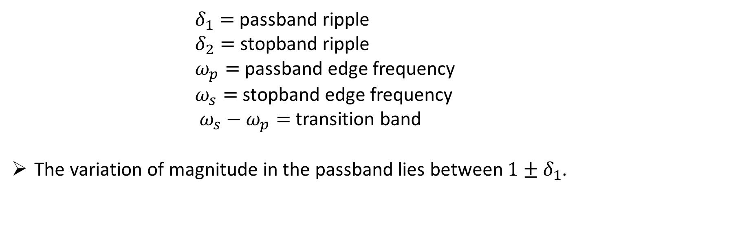
$δ_{1}=$ passband ripple
$δ_{2}=$ stopband ripple
$ω_{p}=$ passband edge frequency
$ω_{s}=$ stopband edge frequency
$ω_{s}−ω_{p}=$ transition band
The variation of magnitude in the passband lies between $1±δ_{1}$.

Slide 9
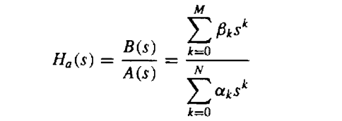
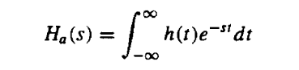
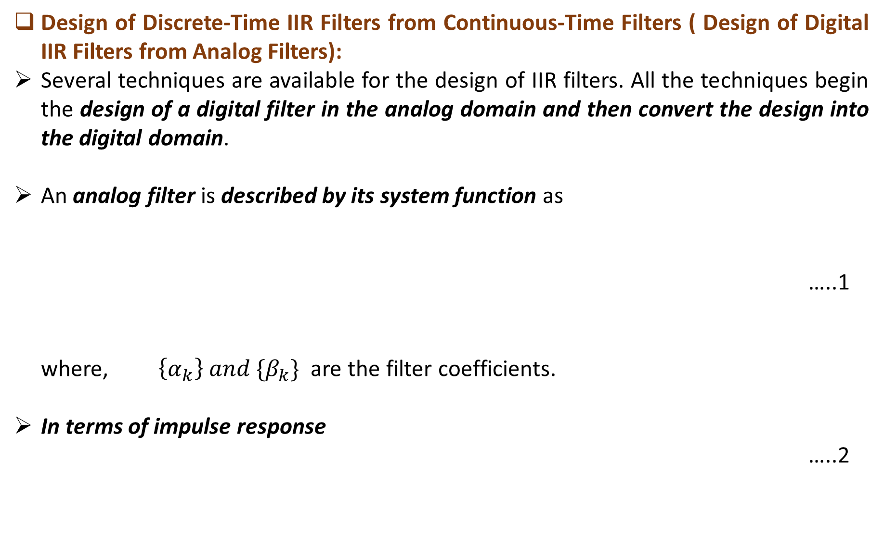
Design of Discrete-Time IIR Filters from Continuous-Time Filters ( Design of Digital IIR Filters from Analog Filters):
Several techniques are available for the design of IIR filters. All the techniques begin the design of a digital filter in the analog domain and then convert the design into the digital domain.
An analog filter is described by its system function as
…..1
where, $\left\{α_{k}\right\} and \{β_{k}\}$ are the filter coefficients.
In terms of impulse response
…..2

Slide 10
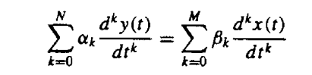
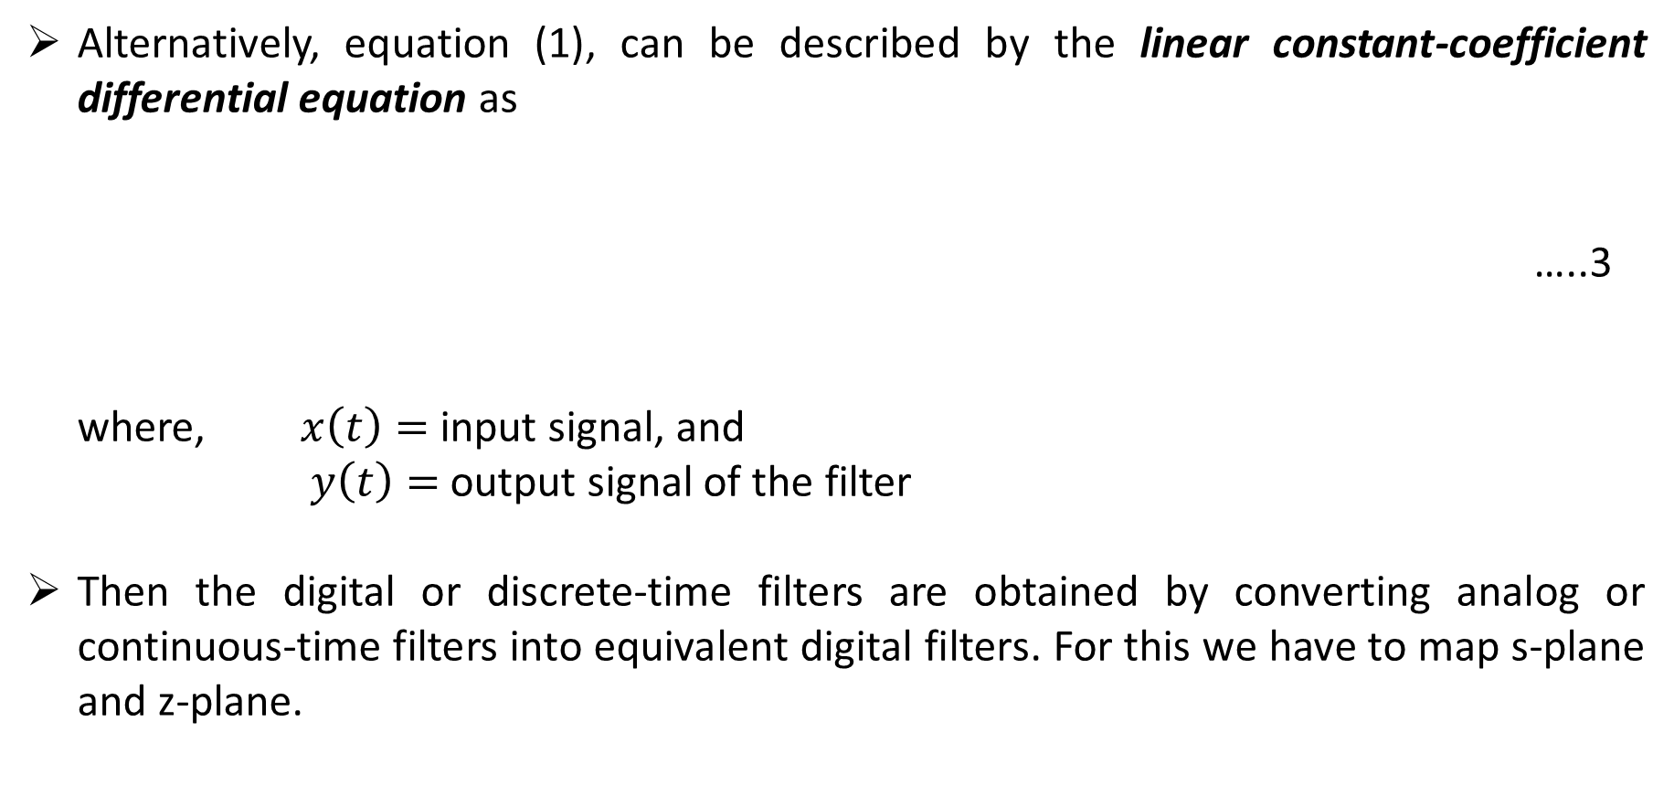
Alternatively, equation (1), can be described by the linear constant-coefficient differential equation as
…..3
where, $x\left(t\right)=$ input signal, and
$y\left(t\right)=$ output signal of the filter
Then the digital or discrete-time filters are obtained by converting analog or continuous-time filters into equivalent digital filters. For this we have to map s-plane and z-plane.

Slide 11
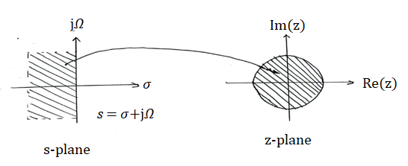
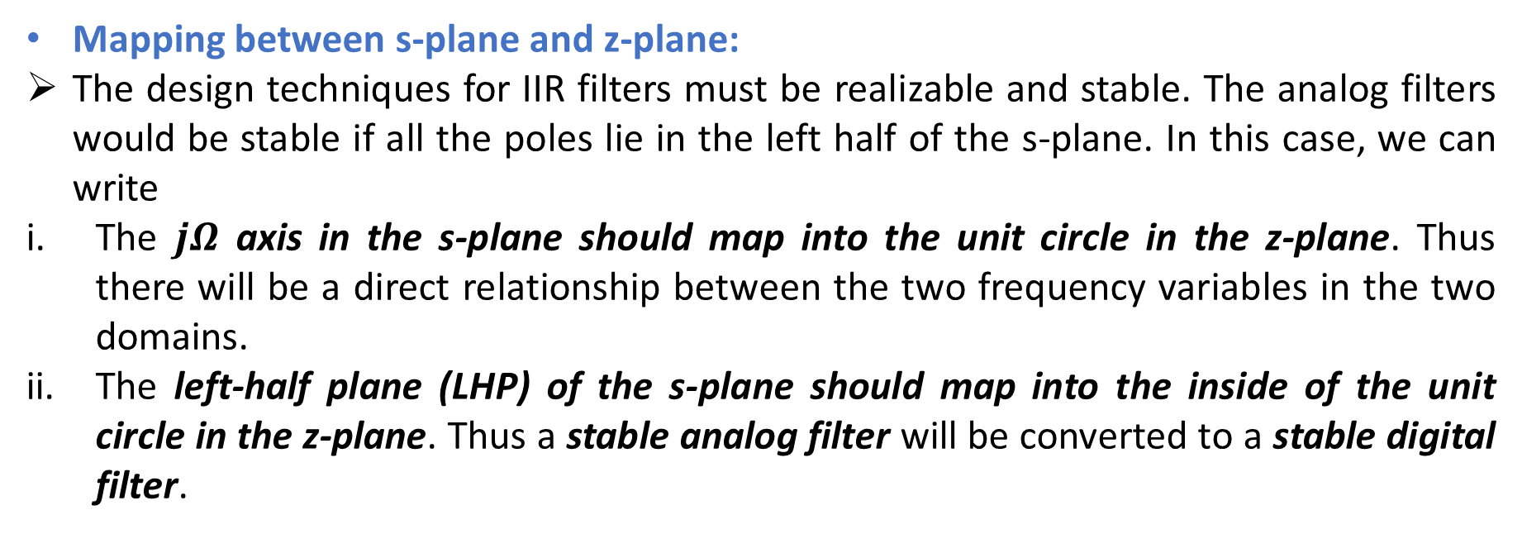
Mapping between s-plane and z-plane:
The design techniques for IIR filters must be realizable and stable. The analog filters would be stable if all the poles lie in the left half of the s-plane. In this case, we can write
The $jΩ$ axis in the s-plane should map into the unit circle in the z-plane. Thus there will be a direct relationship between the two frequency variables in the two domains.
The left-half plane (LHP) of the s-plane should map into the inside of the unit circle in the z-plane. Thus a stable analog filter will be converted to a stable digital filter.

Slide 12

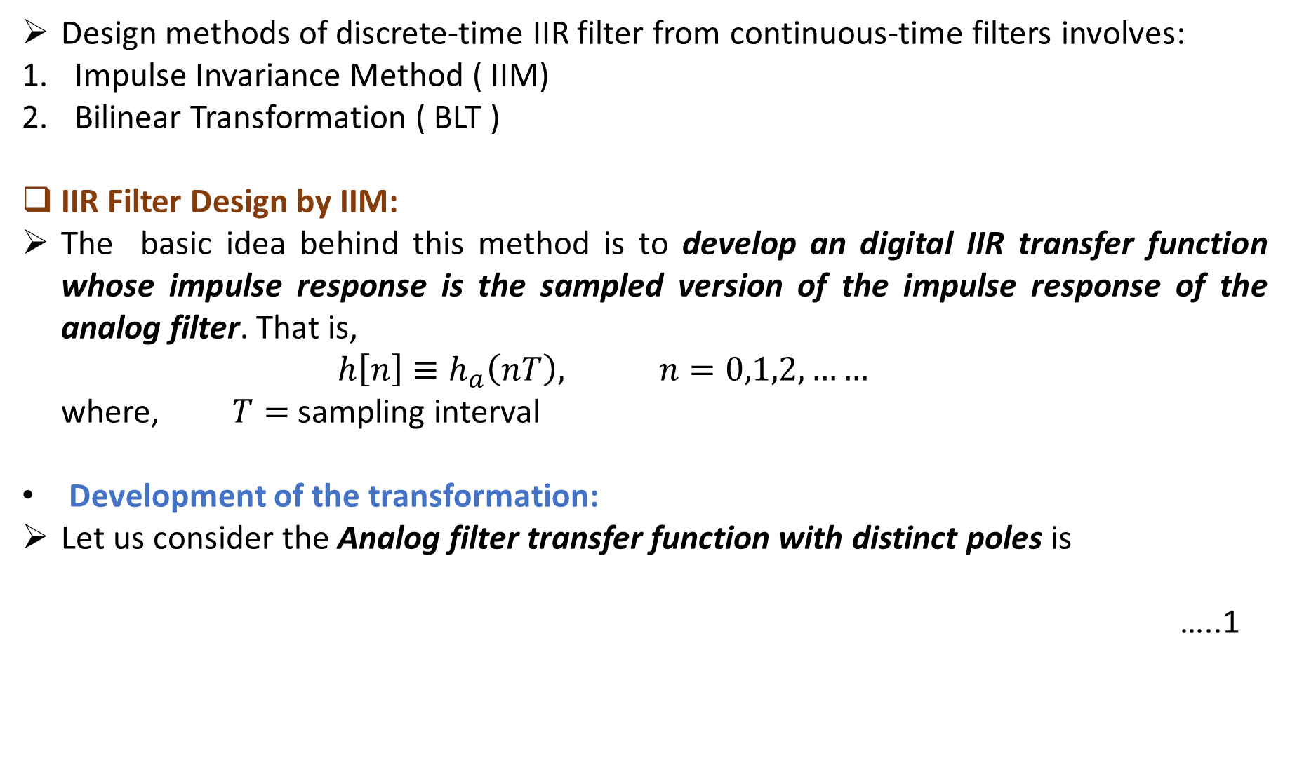
Design methods of discrete-time IIR filter from continuous-time filters involves:
Impulse Invariance Method ( IIM)
Bilinear Transformation ( BLT )
IIR Filter Design by IIM:
The basic idea behind this method is to develop an digital IIR transfer function whose impulse response is the sampled version of the impulse response of the analog filter. That is,
$h\left[n\right]≡h_{a}\left(nT\right), n=0,1,2,……$
where, $T=$ sampling interval
Development of the transformation:
Let us consider the Analog filter transfer function with distinct poles is
…..1

Slide 13
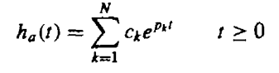
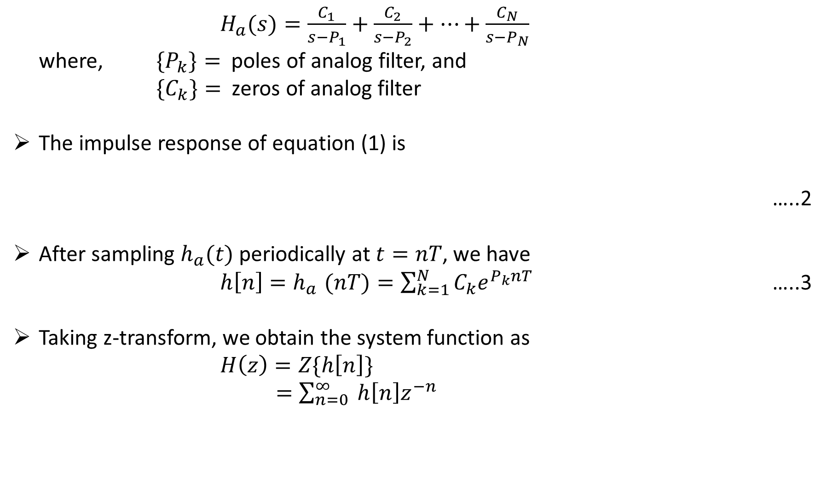
$H_{a}(s)=\frac{C_{1}}{s−P_{1}}+\frac{C_{2}}{s−P_{2}}+…+\frac{C_{N}}{s−P_{N}}$
where, ${\{P}_{k}\}=$ poles of analog filter, and
${\{C}_{k}\}=$ zeros of analog filter
The impulse response of equation (1) is
…..2
After sampling $h_{a}(t)$ periodically at $t=nT$, we have
$h\left[n\right]{=h}_{a}(nT)=\sum_{k=1}^{N}{C_{k}e^{P_{k}nT}}$ …..3
Taking z-transform, we obtain the system function as
$H\left(z\right)=Z\{h\left[n\right]\}$
$=\sum_{n=0}^{∞}{ h\left[n\right]z^{−n}}$

Slide 14
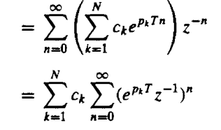
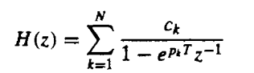
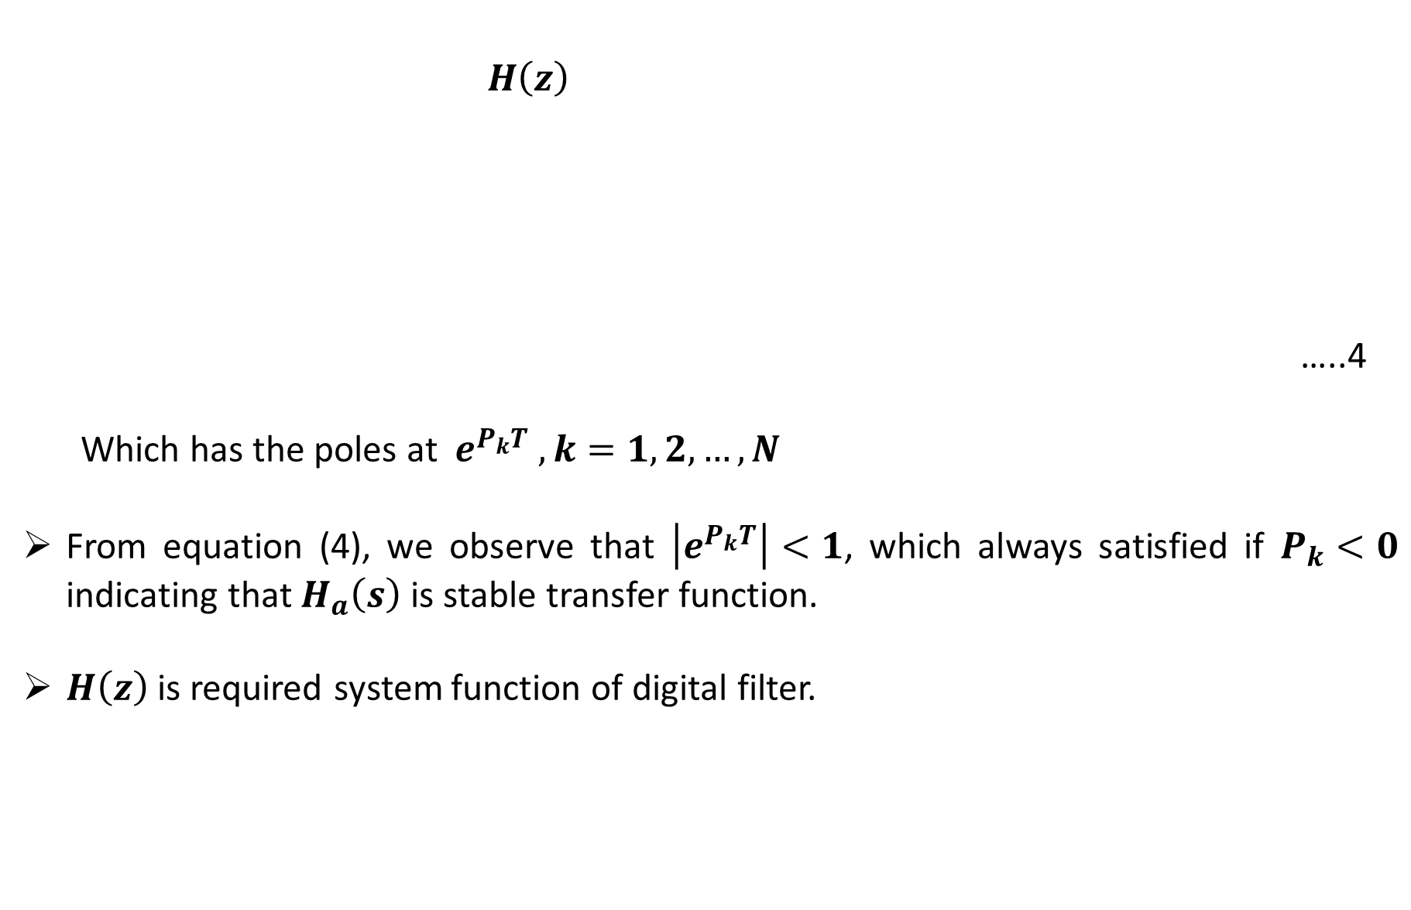
$H\left(z\right)$
…..4
Which has the poles at $e^{P_{k}T} , k=1,2,…,N$
From equation (4), we observe that $\left|e^{P_{k}T}\right|<1$, which always satisfied if $P_{k}<0$ indicating that $H_{a}\left(s\right)$ is stable transfer function.
$H\left(z\right)$ is required system function of digital filter.

Slide 15
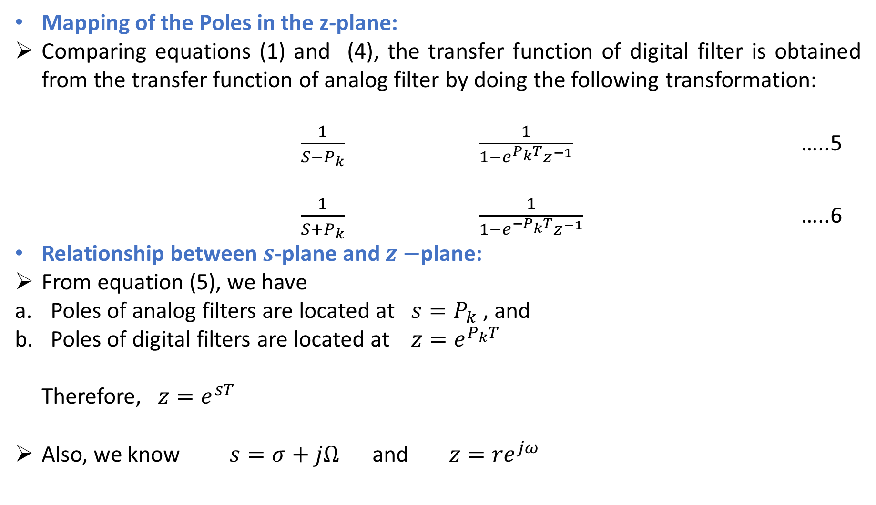
Mapping of the Poles in the z-plane:
Comparing equations (1) and (4), the transfer function of digital filter is obtained from the transfer function of analog filter by doing the following transformation:
$\frac{1}{S−P_{k}} \frac{1}{1−e^{P_{k}T}z^{−1}}$ …..5
$\frac{1}{S+P_{k}} \frac{1}{1−e^{{−P}_{k}T}z^{−1}}$ …..6
Relationship between $s$-plane and $z−$plane:
From equation (5), we have
Poles of analog filters are located at $s=P_{k}$ , and
Poles of digital filters are located at $z=e^{P_{k}T}$
Therefore, $z=e^{sT}$
Also, we know $s=σ+jΩ$ and $z={re}^{jω}$

Slide 16
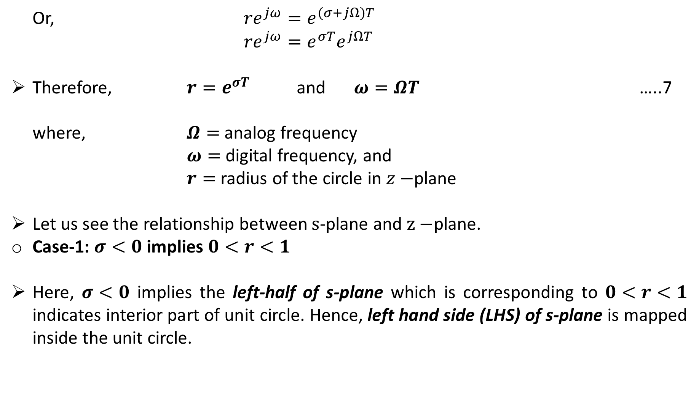
Or, ${re}^{jω}=e^{(σ+jΩ)T}$
${re}^{jω}=e^{σT}e^{jΩT}$
Therefore, $r=e^{σT}$ and $ω=ΩT$ …..7
where, $Ω=$ analog frequency
$ω=$ digital frequency, and
$r=$ radius of the circle in $z−$plane
Let us see the relationship between $s$-plane and $z−$plane.
Case-1: $σ<0$ implies $0<r<1$
Here, $σ<0$ implies the left-half of s-plane which is corresponding to $0<r<1$ indicates interior part of unit circle. Hence, left hand side (LHS) of s-plane is mapped inside the unit circle.

Slide 17
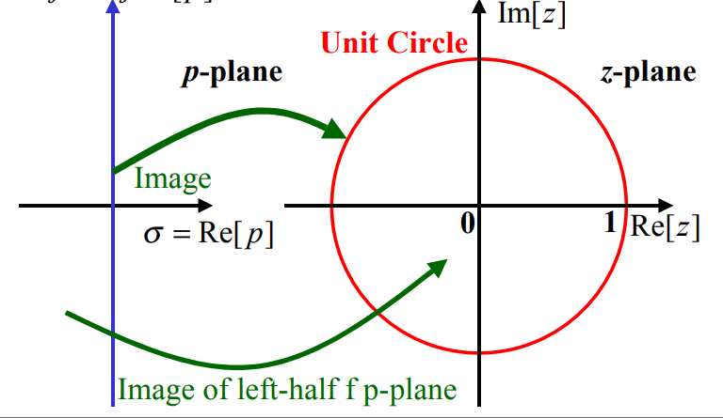
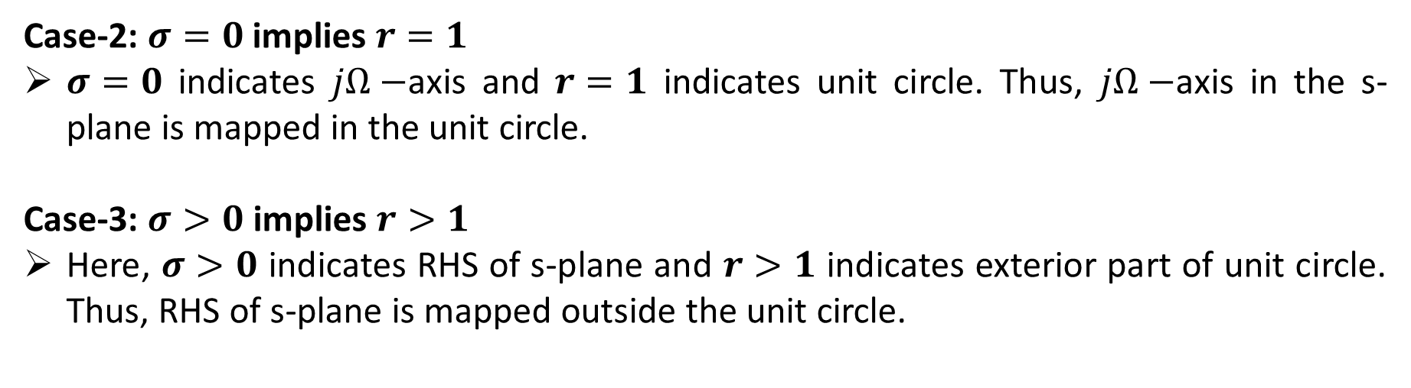
Case-2: $σ=0$ implies $r=1$
$σ=0$ indicates $jΩ−$axis and $r=1$ indicates unit circle. Thus, $jΩ−$axis in the s-plane is mapped in the unit circle.
Case-3: $σ>0$ implies $r>1$
Here, $σ>0$ indicates RHS of s-plane and $r>1$ indicates exterior part of unit circle. Thus, RHS of s-plane is mapped outside the unit circle.

Slide 18
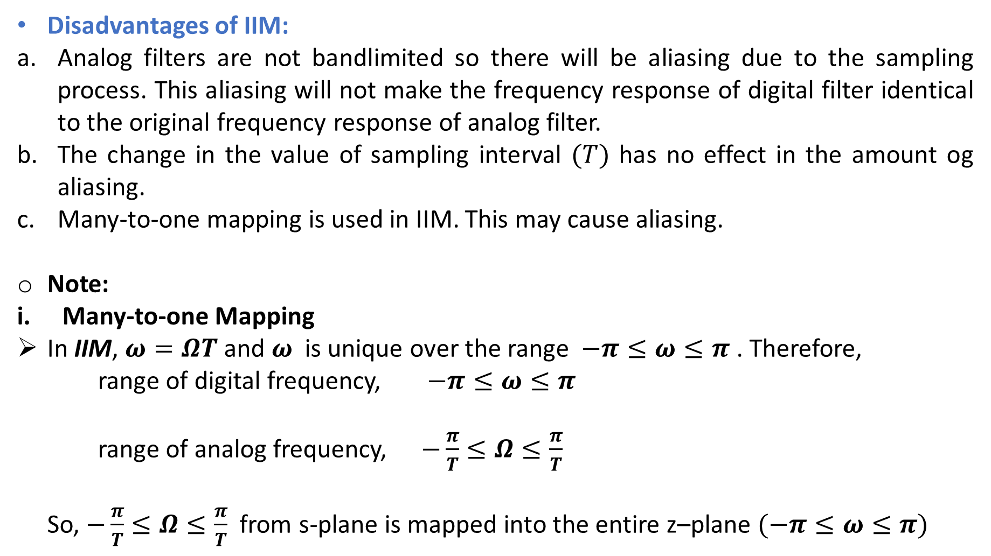
Disadvantages of IIM:
Analog filters are not bandlimited so there will be aliasing due to the sampling process. This aliasing will not make the frequency response of digital filter identical to the original frequency response of analog filter.
The change in the value of sampling interval $(T)$ has no effect in the amount og aliasing.
Many-to-one mapping is used in IIM. This may cause aliasing.
Note:
Many-to-one Mapping
In IIM, $ω=ΩT$and $ω$ is unique over the range $−π≤ω≤π$ . Therefore,
range of digital frequency, $−π≤ω≤π$
range of analog frequency, $−\frac{π}{T}≤Ω≤\frac{π}{T}$
So, $−\frac{π}{T}≤Ω≤\frac{π}{T}$ from s-plane is mapped into the entire z–plane $(−π≤ω≤π)$

Slide 19
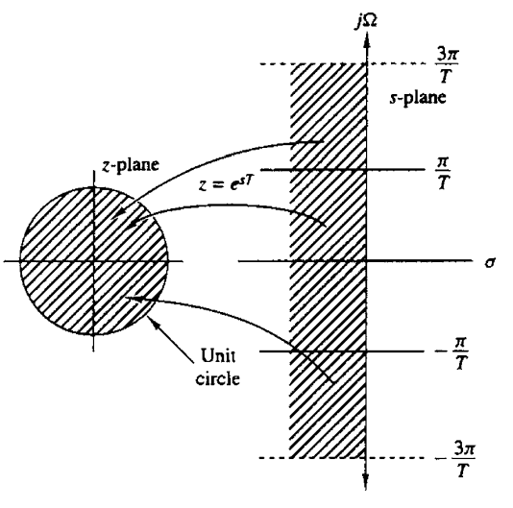
In general, $(2k−1)\frac{π}{T}≤Ω≤(2k+1)\frac{π}{T}$ is mapped in the entire z–plane $(−π≤ω≤π)$. Hence, mapping from $Ω$ to $ω$ is termed as many-to-one.

Slide 20
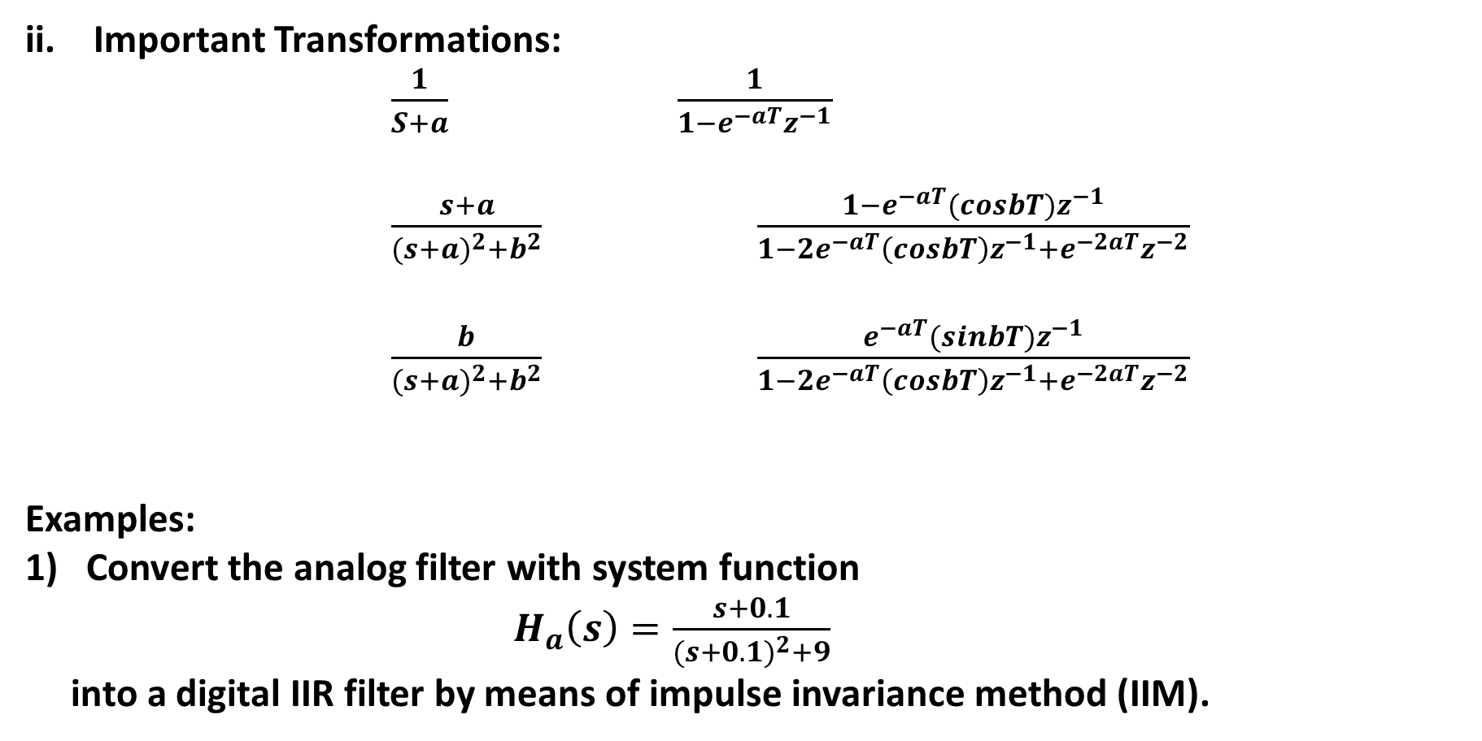
Important Transformations:
$\frac{1}{S+a} \frac{1}{1−e^{−aT}z^{−1}}$
$\frac{s+a}{{(s+a)}^{2}+b^{2}}$ $\frac{1−e^{−aT}(cosbT)z^{−1}}{1−2e^{−aT}\left(cosbT\right)z^{−1}+e^{−2aT}z^{−2}}$
$\frac{b}{{(s+a)}^{2}+b^{2}}$ $\frac{e^{−aT}(sinbT)z^{−1}}{1−2e^{−aT}\left(cosbT\right)z^{−1}+e^{−2aT}z^{−2}}$
Examples:
Convert the analog filter with system function
$H_{a}\left(s\right)=\frac{s+0.1}{{(s+0.1)}^{2}+9}$
into a digital IIR filter by means of impulse invariance method (IIM).

Slide 21
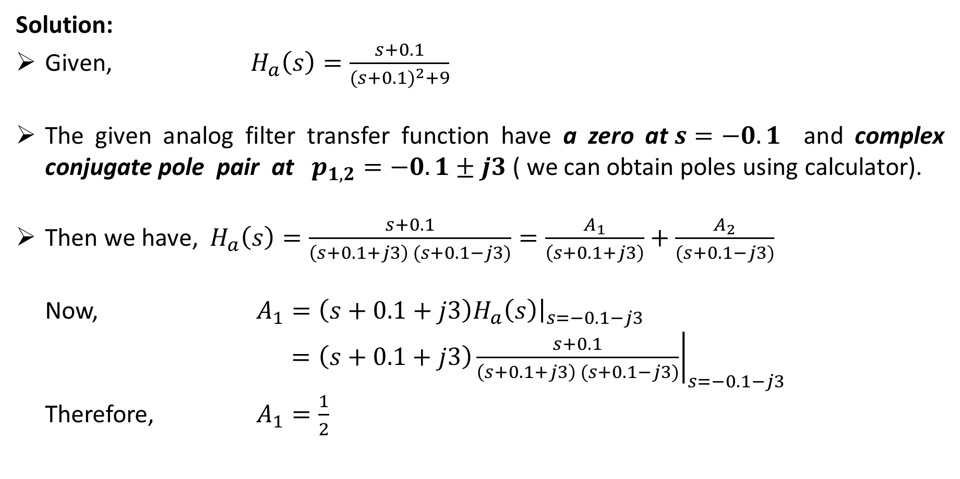
Solution:
Given, $H_{a}\left(s\right)=\frac{s+0.1}{{(s+0.1)}^{2}+9}$
The given analog filter transfer function have a zero at$s=−0.1$ and complex conjugate pole pair at $p_{1,2}=−0.1±j3$ ( we can obtain poles using calculator).
Then we have,$H_{a}\left(s\right)=\frac{s+0.1}{\left(s+0.1+j3\right) (s+0.1−j3)}=\frac{A_{1}}{\left(s+0.1+j3\right)}+\frac{A_{2}}{(s+0.1−j3)}$
Now, $A_{1}={\left.\left(s+0.1+j3\right)H_{a}\left(s\right)\right|}_{s=−0.1−j3}$
$={\left.\left(s+0.1+j3\right)\frac{s+0.1}{\left(s+0.1+j3\right) (s+0.1−j3)}\right|}_{s=−0.1−j3}$
Therefore, $A_{1}=\frac{1}{2}$

Slide 22
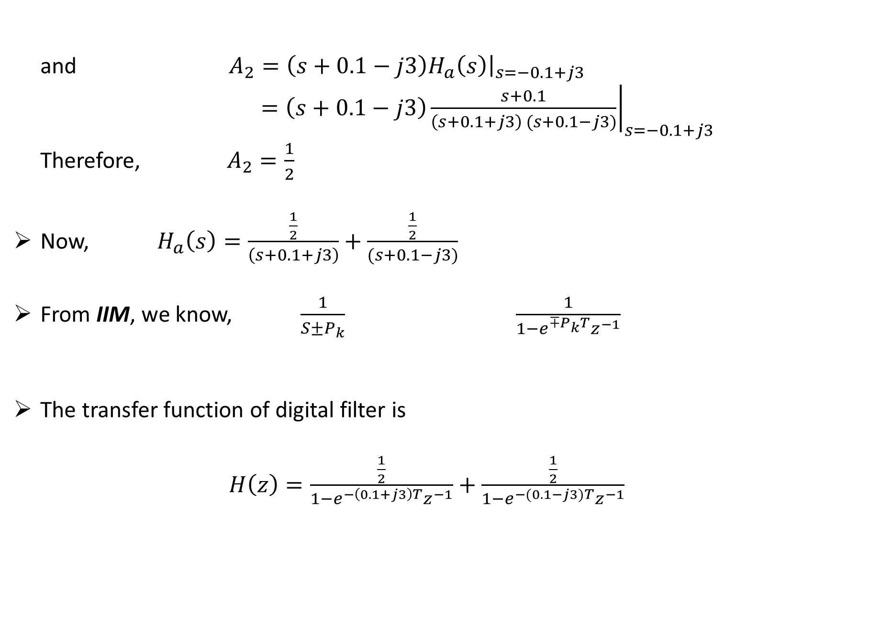
and $A_{2}={\left.\left(s+0.1−j3\right)H_{a}\left(s\right)\right|}_{s=−0.1+j3}$
$={\left.\left(s+0.1−j3\right)\frac{s+0.1}{\left(s+0.1+j3\right) (s+0.1−j3)}\right|}_{s=−0.1+j3}$
Therefore, $A_{2}=\frac{1}{2}$
Now, $H_{a}\left(s\right)=\frac{\frac{1}{2}}{\left(s+0.1+j3\right)}+\frac{\frac{1}{2}}{(s+0.1−j3)}$
From IIM, we know, $\frac{1}{S±P_{k}}$ $\frac{1}{1−e^{∓P_{k}T}z^{−1}}$
The transfer function of digital filter is
$H\left(z\right)=\frac{\frac{1}{2}}{1−e^{−\left(0.1+j3\right)T}z^{−1}}+\frac{\frac{1}{2}}{1−e^{−(0.1−j3)T}z^{−1}}$

Slide 23
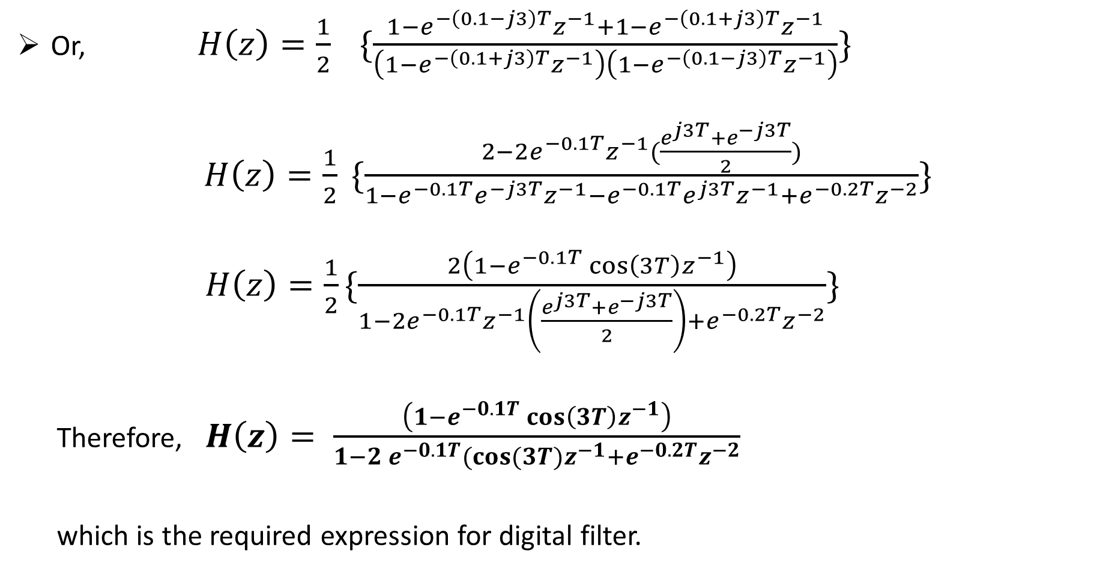
Or, $H\left(z\right)=\frac{1}{2} \{\frac{1−e^{−\left(0.1−j3\right)T}z^{−1}+1−e^{−\left(0.1+j3\right)T}z^{−1}}{\left(1−e^{−\left(0.1+j3\right)T}z^{−1}\right)\left({1−e}^{−\left(0.1−j3\right)T}z^{−1}\right)}\}$
$H\left(z\right)=\frac{1}{2} \{\frac{2−2e^{−0.1T}z^{−1}(\frac{e^{j3T}+e^{−j3T}}{2})}{1−e^{−0.1T}e^{−j3T}z^{−1}−e^{−0.1T}e^{j3T}z^{−1}+e^{−0.2T}z^{−2}}\}$
$H\left(z\right)=\frac{1}{2}\{\frac{2\left(1−e^{−0.1T}{\cos\left(3T\right)z}^{−1}\right)}{1−2e^{−0.1T}z^{−1}\left(\frac{e^{j3T}+e^{−j3T}}{2}\right)+e^{−0.2T}z^{−2}}\}$
Therefore, $H\left(z\right)= \frac{\left(1−e^{−0.1T}{\cos\left(3T\right)z}^{−1}\right)}{1−2 e^{−0.1T}(cos⁡(3T)z^{−1}+e^{−0.2T}z^{−2}}$
which is the required expression for digital filter.

Slide 24
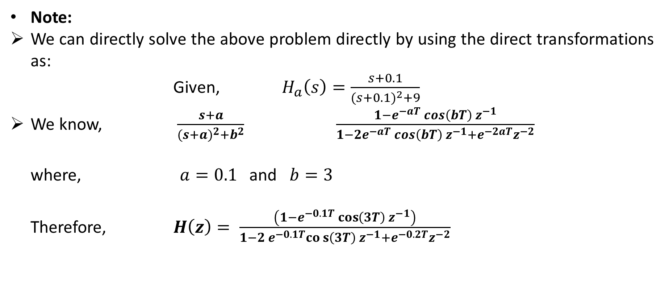
Note:
We can directly solve the above problem directly by using the direct transformations as:
Given, $H_{a}\left(s\right)=\frac{s+0.1}{{(s+0.1)}^{2}+9}$
We know, $\frac{s+a}{{(s+a)}^{2}+b^{2}}$ $\frac{1−e^{−aT} cos\left(bT\right) z^{−1}}{1−2e^{−aT} cos\left(bT\right) z^{−1}+e^{−2aT}z^{−2}}$
where, $a=0.1$ and $b=3$
Therefore, $H\left(z\right)= \frac{\left(1−e^{−0.1T}{\cos\left(3T\right) z}^{−1}\right)}{1−2 e^{−0.1T}cos\left(3T\right) z^{−1}+e^{−0.2T}z^{−2}}$

Slide 25
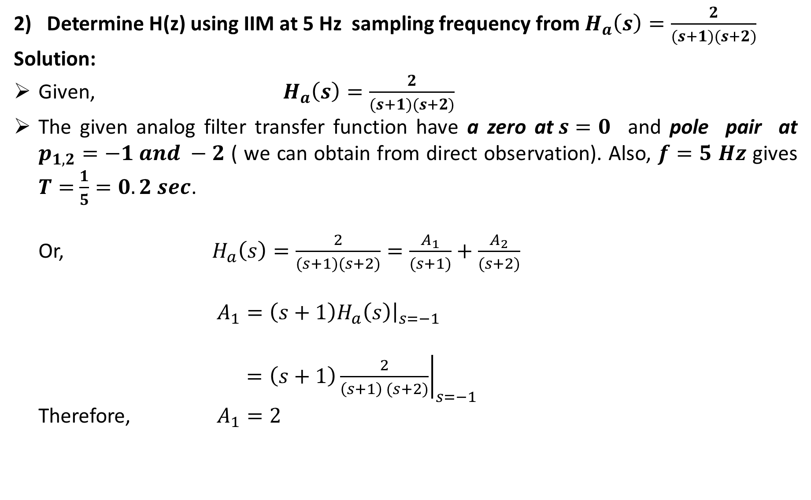
Determine H(z) using IIM at 5 Hz sampling frequency from $H_{a}\left(s\right)=\frac{2}{(s+1)(s+2)}$
Solution:
Given, $H_{a}\left(s\right)=\frac{2}{(s+1)(s+2)}$
The given analog filter transfer function have a zero at$s=0$ and pole pair at $p_{1,2}=−1 and −2$ ( we can obtain from direct observation). Also, $f=5$ $Hz$ gives $T=$ $\frac{1}{5}=0.2 sec$.
Or, $H_{a}\left(s\right)=\frac{2}{(s+1)(s+2)}=\frac{A_{1}}{(s+1)}+\frac{A_{2}}{(s+2)}$
$A_{1}={\left.\left(s+1\right)H_{a}\left(s\right)\right|}_{s=−1}$
$={\left.\left(s+1\right)\frac{2}{\left(s+1\right) (s+2)}\right|}_{s=−1}$
Therefore, $A_{1}=2$

Slide 26
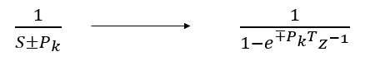
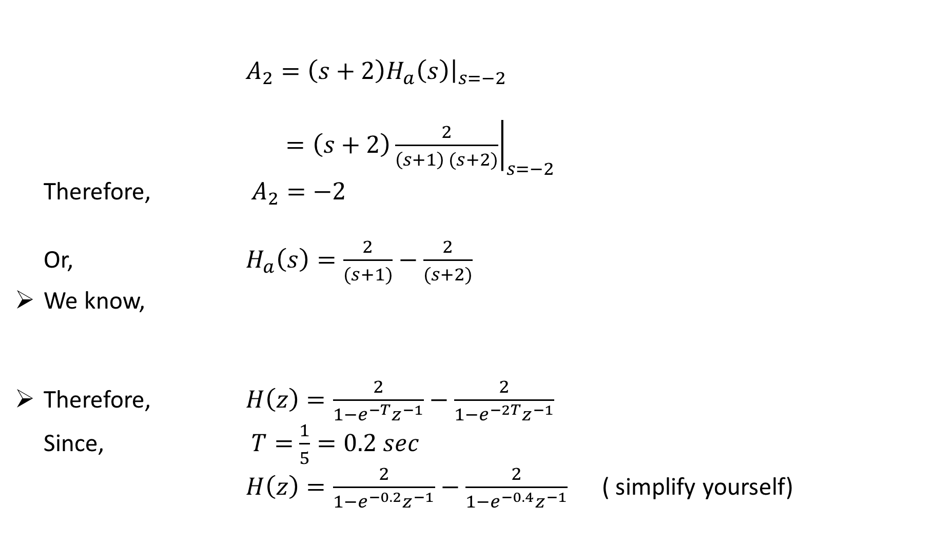
$A_{2}={\left.\left(s+2\right)H_{a}\left(s\right)\right|}_{s=−2}$
$={\left.\left(s+2\right)\frac{2}{\left(s+1\right) (s+2)}\right|}_{s=−2}$
Therefore, $A_{2}=−2$
Or, $H_{a}\left(s\right)=\frac{2}{(s+1)}−\frac{2}{(s+2)}$
We know,
Therefore, $H\left(z\right)=\frac{2}{1−e^{−T}z^{−1}}−\frac{2}{1−e^{−2T}z^{−1}}$
Since, $T=$ $\frac{1}{5}=0.2 sec$
$H\left(z\right)=\frac{2}{1−e^{−0.2}z^{−1}}−\frac{2}{1−e^{−0.4}z^{−1}}$ ( simplify yourself)

Slide 28
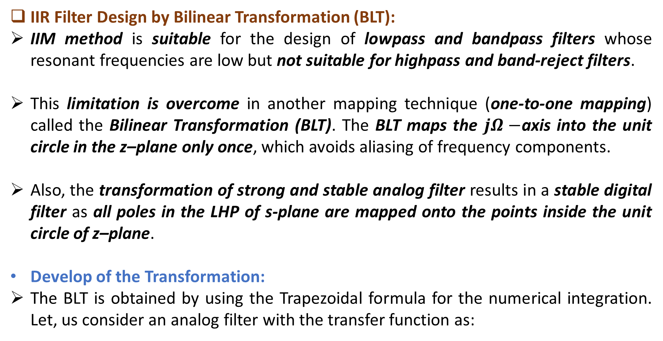
IIR Filter Design by Bilinear Transformation (BLT):
IIM method is suitable for the design of lowpass and bandpass filters whose resonant frequencies are low but not suitable for highpass and band-reject filters.
This limitation is overcome in another mapping technique (one-to-one mapping) called the Bilinear Transformation (BLT). The BLT maps the $jΩ−$axis into the unit circle in the z–plane only once, which avoids aliasing of frequency components.
Also, the transformation of strong and stable analog filter results in a stable digital filter as all poles in the LHP of s-plane are mapped onto the points inside the unit circle of z–plane.
Develop of the Transformation:
The BLT is obtained by using the Trapezoidal formula for the numerical integration. Let, us consider an analog filter with the transfer function as:

Slide 29
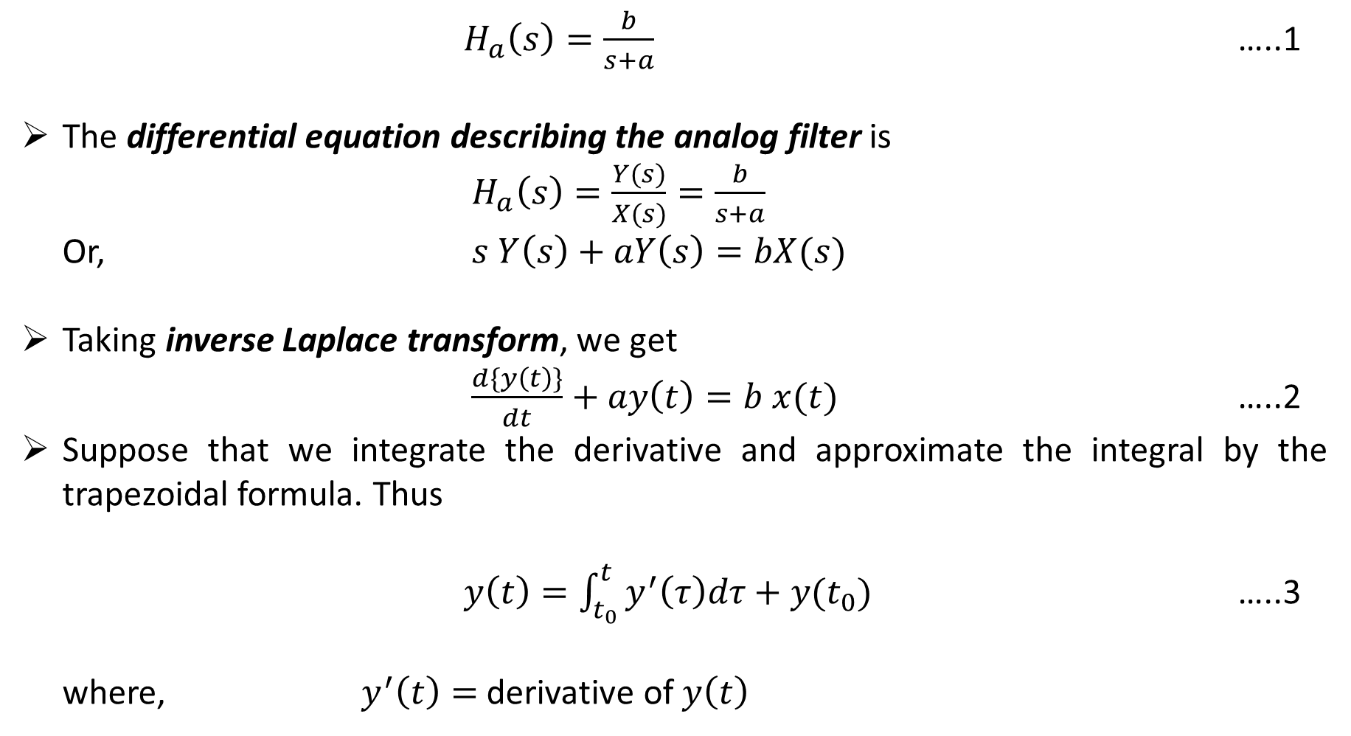
$H_{a}\left(s\right)=\frac{b}{s+a}$ …..1
The differential equation describing the analog filter is
$H_{a}\left(s\right)=\frac{Y(s)}{X(s)}=\frac{b}{s+a}$
Or, $s Y\left(s\right)+aY\left(s\right)=bX(s)$
Taking inverse Laplace transform, we get
$\frac{d\{y\left(t\right)\}}{dt}+ay\left(t\right)=b x(t)$ …..2
Suppose that we integrate the derivative and approximate the integral by the trapezoidal formula. Thus
$y\left(t\right)=\int_{t_{0}}^{t}{y^{′}\left(τ\right)dτ+y(t_{0})}$ …..3
where, $y^{′}\left(t\right)=$ derivative of $y\left(t\right)$

Slide 30
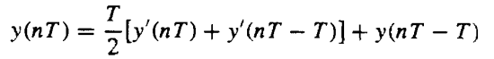
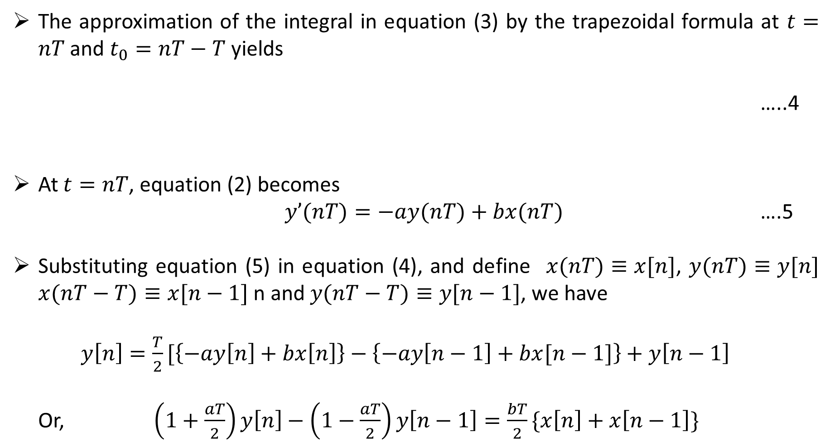
The approximation of the integral in equation (3) by the trapezoidal formula at $t=nT$ and $t_{0}=nT−T$ yields
…..4
At $t=nT$, equation (2) becomes
$y’(nT)=−ay(nT)+bx(nT)$ ….5
Substituting equation (5) in equation (4), and define $x(nT)≡x[n]$, $y(nT)≡y[n]$ $x(nT−T)≡x[n−1]$ n and $y(nT−T)≡y[n−1]$, we have
$y\left[n\right]=\frac{T}{2}[\left\{−ay\left[n\right]+bx\left[n\right]\right\}−\left\{−ay\left[n−1\right]+bx[n−1]\right\}+y\left[n−1\right]$
Or, $\left(1+\frac{aT}{2}\right)y\left[n\right]−\left(1−\frac{aT}{2}\right)y\left[n−1\right]=\frac{bT}{2}\{x\left[n\right]+x\left[n−1\right]\}$

Slide 31
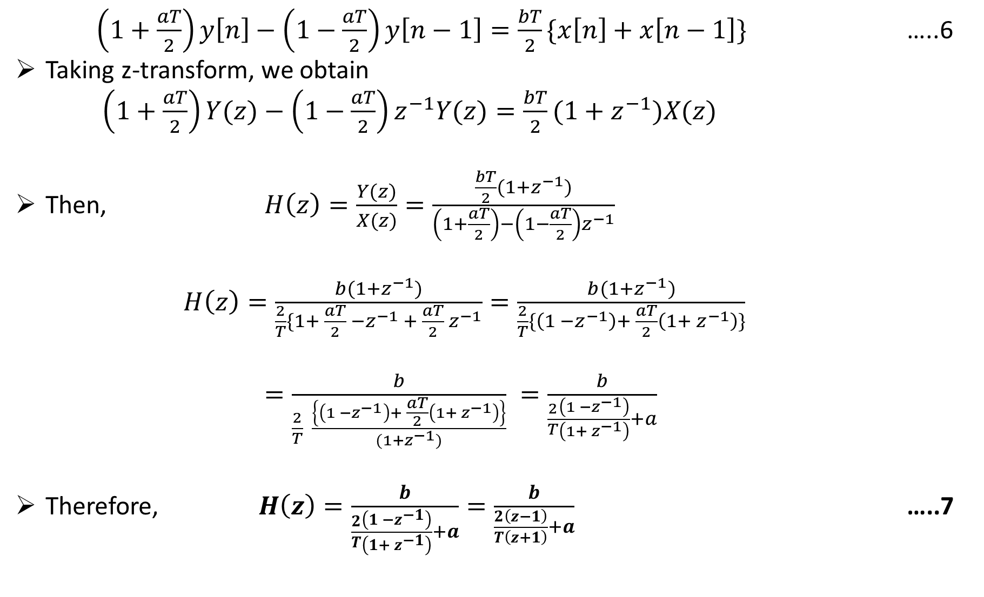
$\left(1+\frac{aT}{2}\right)y\left[n\right]−\left(1−\frac{aT}{2}\right)y\left[n−1\right]=\frac{bT}{2}\{x\left[n\right]+x\left[n−1\right]\}$ …..6
Taking z-transform, we obtain
$\left(1+\frac{aT}{2}\right)Y(z)−\left(1−\frac{aT}{2}\right)z^{−1}Y(z)=\frac{bT}{2}(1+z^{−1})X(z)$
Then, $H\left(z\right)=\frac{Y(z)}{X(z)}=\frac{\frac{bT}{2}(1+z^{−1})}{\left(1+\frac{aT}{2}\right)−\left(1−\frac{aT}{2}\right)z^{−1}}$
$H\left(z\right)=\frac{b(1+z^{−1})}{\frac{2}{T}\{1+ \frac{aT}{2} −z^{−1} + \frac{aT}{2} z^{−1}}=\frac{b(1+z^{−1})}{\frac{2}{T}\{\left(1 −z^{−1}\right)+ \frac{aT}{2}\left(1+ z^{−1}\right)\}}$
$=\frac{b}{\frac{2}{T} \frac{\left\{\left(1 −z^{−1}\right)+ \frac{aT}{2}\left(1+ z^{−1}\right)\right\}}{(1+z^{−1})}} =\frac{b}{\frac{2}{T}\frac{\left(1 −z^{−1}\right)}{\left(1+ z^{−1}\right)}+a}$
Therefore, $H\left(z\right)=\frac{b}{\frac{2}{T}\frac{\left(1 −z^{−1}\right)}{\left(1+ z^{−1}\right)}+a}=\frac{b}{\frac{2}{T}\frac{\left(z−1\right)}{\left(z+1\right)}+a}$ …..7

Slide 32
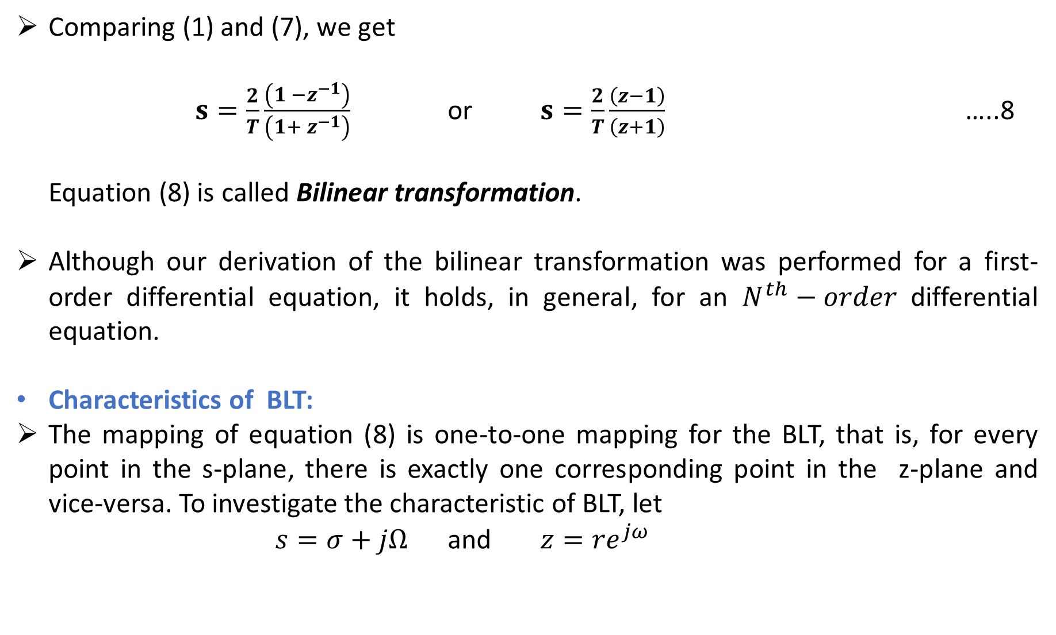
Comparing (1) and (7), we get
$s=\frac{2}{T}\frac{\left(1 −z^{−1}\right)}{\left(1+ z^{−1}\right)}$ or $s=\frac{2}{T}\frac{\left(z−1\right)}{\left(z+1\right)}$ …..8
Equation (8) is called Bilinear transformation.
Although our derivation of the bilinear transformation was performed for a first-order differential equation, it holds, in general, for an $N^{th}−order$ differential equation.
Characteristics of BLT:
The mapping of equation (8) is one-to-one mapping for the BLT, that is, for every point in the s-plane, there is exactly one corresponding point in the z-plane and vice-versa. To investigate the characteristic of BLT, let
$s=σ+jΩ$ and $z={re}^{jω}$

Slide 33
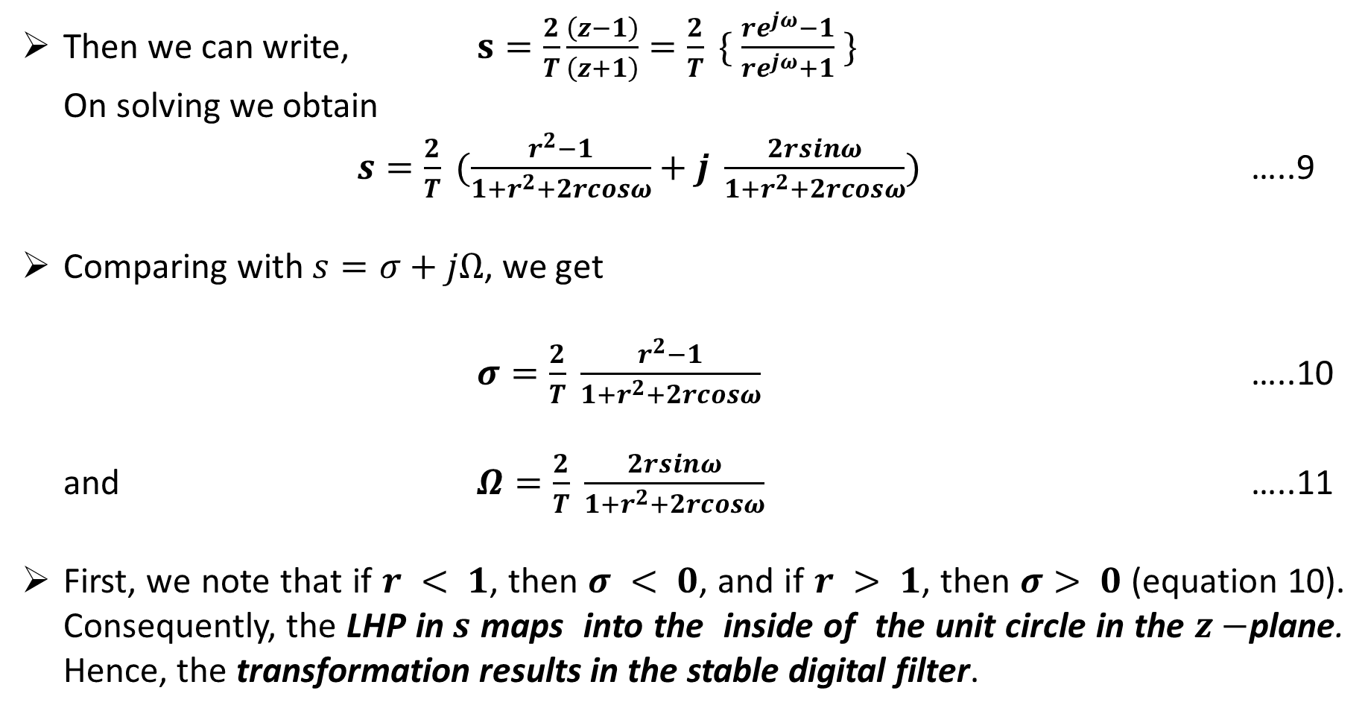
Then we can write, $s=\frac{2}{T}\frac{\left(z−1\right)}{\left(z+1\right)}=\frac{2}{T} \{ \frac{re^{jω}−1}{re^{jω}+1} \}$
On solving we obtain
$s=\frac{2}{T} (\frac{r^{2}−1}{1+r^{2}+2rcosω}+j \frac{2rsinω}{1+r^{2}+2rcosω})$ …..9
Comparing with $s=σ+jΩ$, we get
$σ=\frac{2}{T} \frac{r^{2}−1}{1+r^{2}+2rcosω}$ …..10
and $Ω=\frac{2}{T} \frac{2rsinω}{1+r^{2}+2rcosω}$ …..11
First, we note that if $r < 1$, then $σ < 0$, and if $r > 1$, then $σ> 0$(equation 10). Consequently, the LHP in$s$ maps into the inside of the unit circle in the $z−$plane. Hence, the transformation results in the stable digital filter.

Slide 34
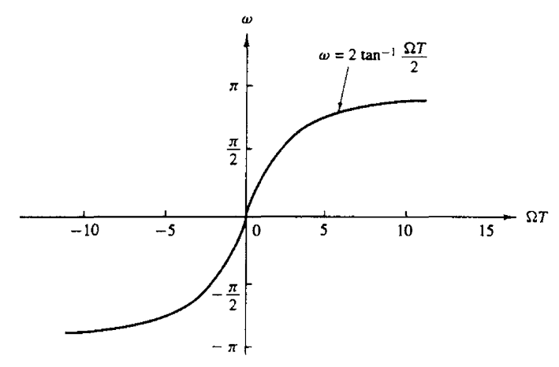
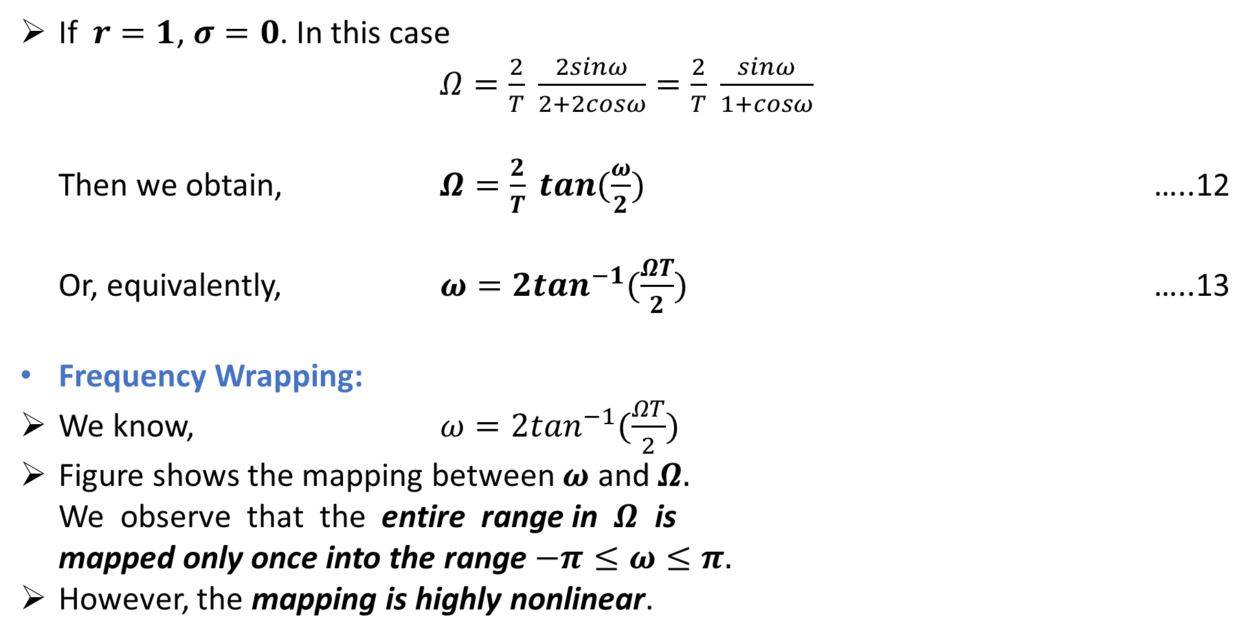
If $r=1$, $σ=0$. In this case
$Ω=\frac{2}{T} \frac{2sinω}{2+2cosω}=\frac{2}{T} \frac{sinω}{1+cosω}$
Then we obtain, $Ω=\frac{2}{T} tan(\frac{ω}{2})$ …..12
Or, equivalently, $ω=2\tan^{−1}(\frac{ΩT}{2})$ …..13
Frequency Wrapping:
We know, $ω=2\tan^{−1}(\frac{ΩT}{2})$
Figure shows the mapping between $ω$ and $Ω.$
We observe that the entire range in $Ω$ is
mapped only once into the range $−π≤ω≤π.$
However, the mapping is highly nonlinear.

Slide 35
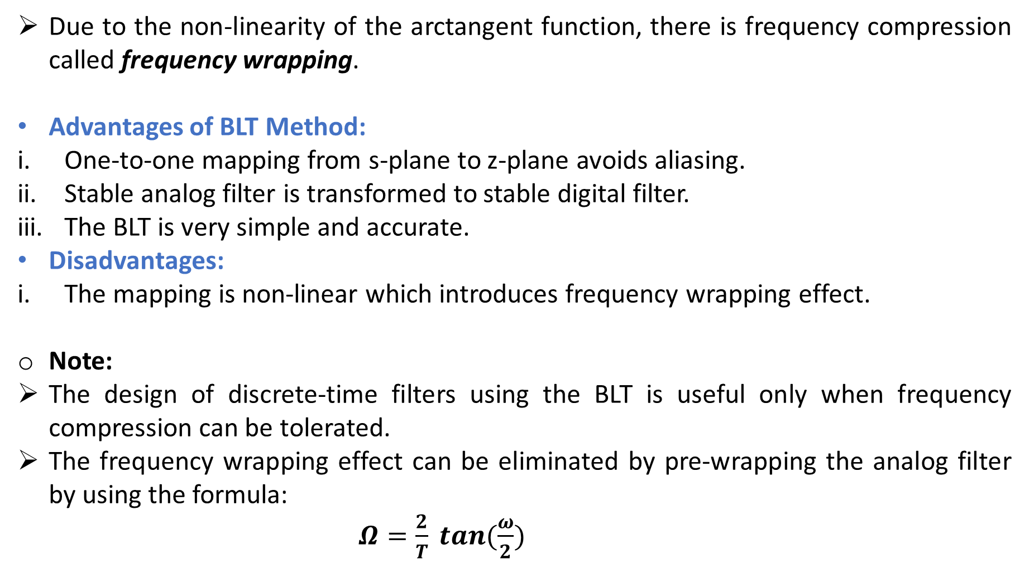
Due to the non-linearity of the arctangent function, there is frequency compression called frequency wrapping.
Advantages of BLT Method:
One-to-one mapping from s-plane to z-plane avoids aliasing.
Stable analog filter is transformed to stable digital filter.
The BLT is very simple and accurate.
Disadvantages:
The mapping is non-linear which introduces frequency wrapping effect.
Note:
The design of discrete-time filters using the BLT is useful only when frequency compression can be tolerated.
The frequency wrapping effect can be eliminated by pre-wrapping the analog filter by using the formula:
$Ω=\frac{2}{T} tan(\frac{ω}{2})$

Slide 36
Comparison between IIM and BLT:

Slide 37
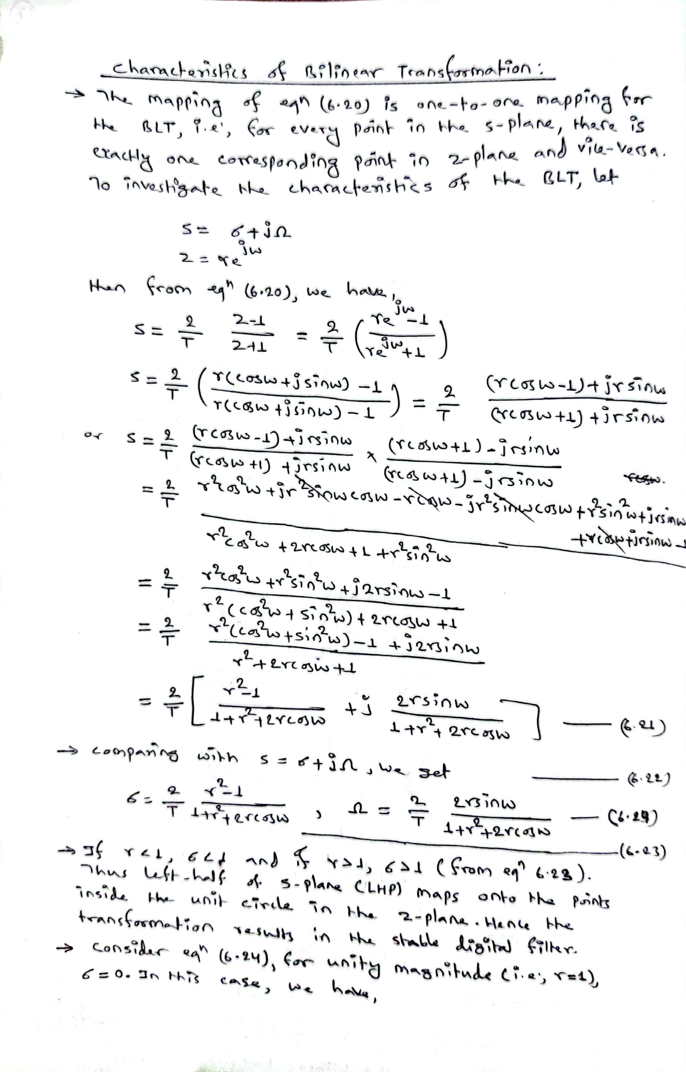

Slide 38
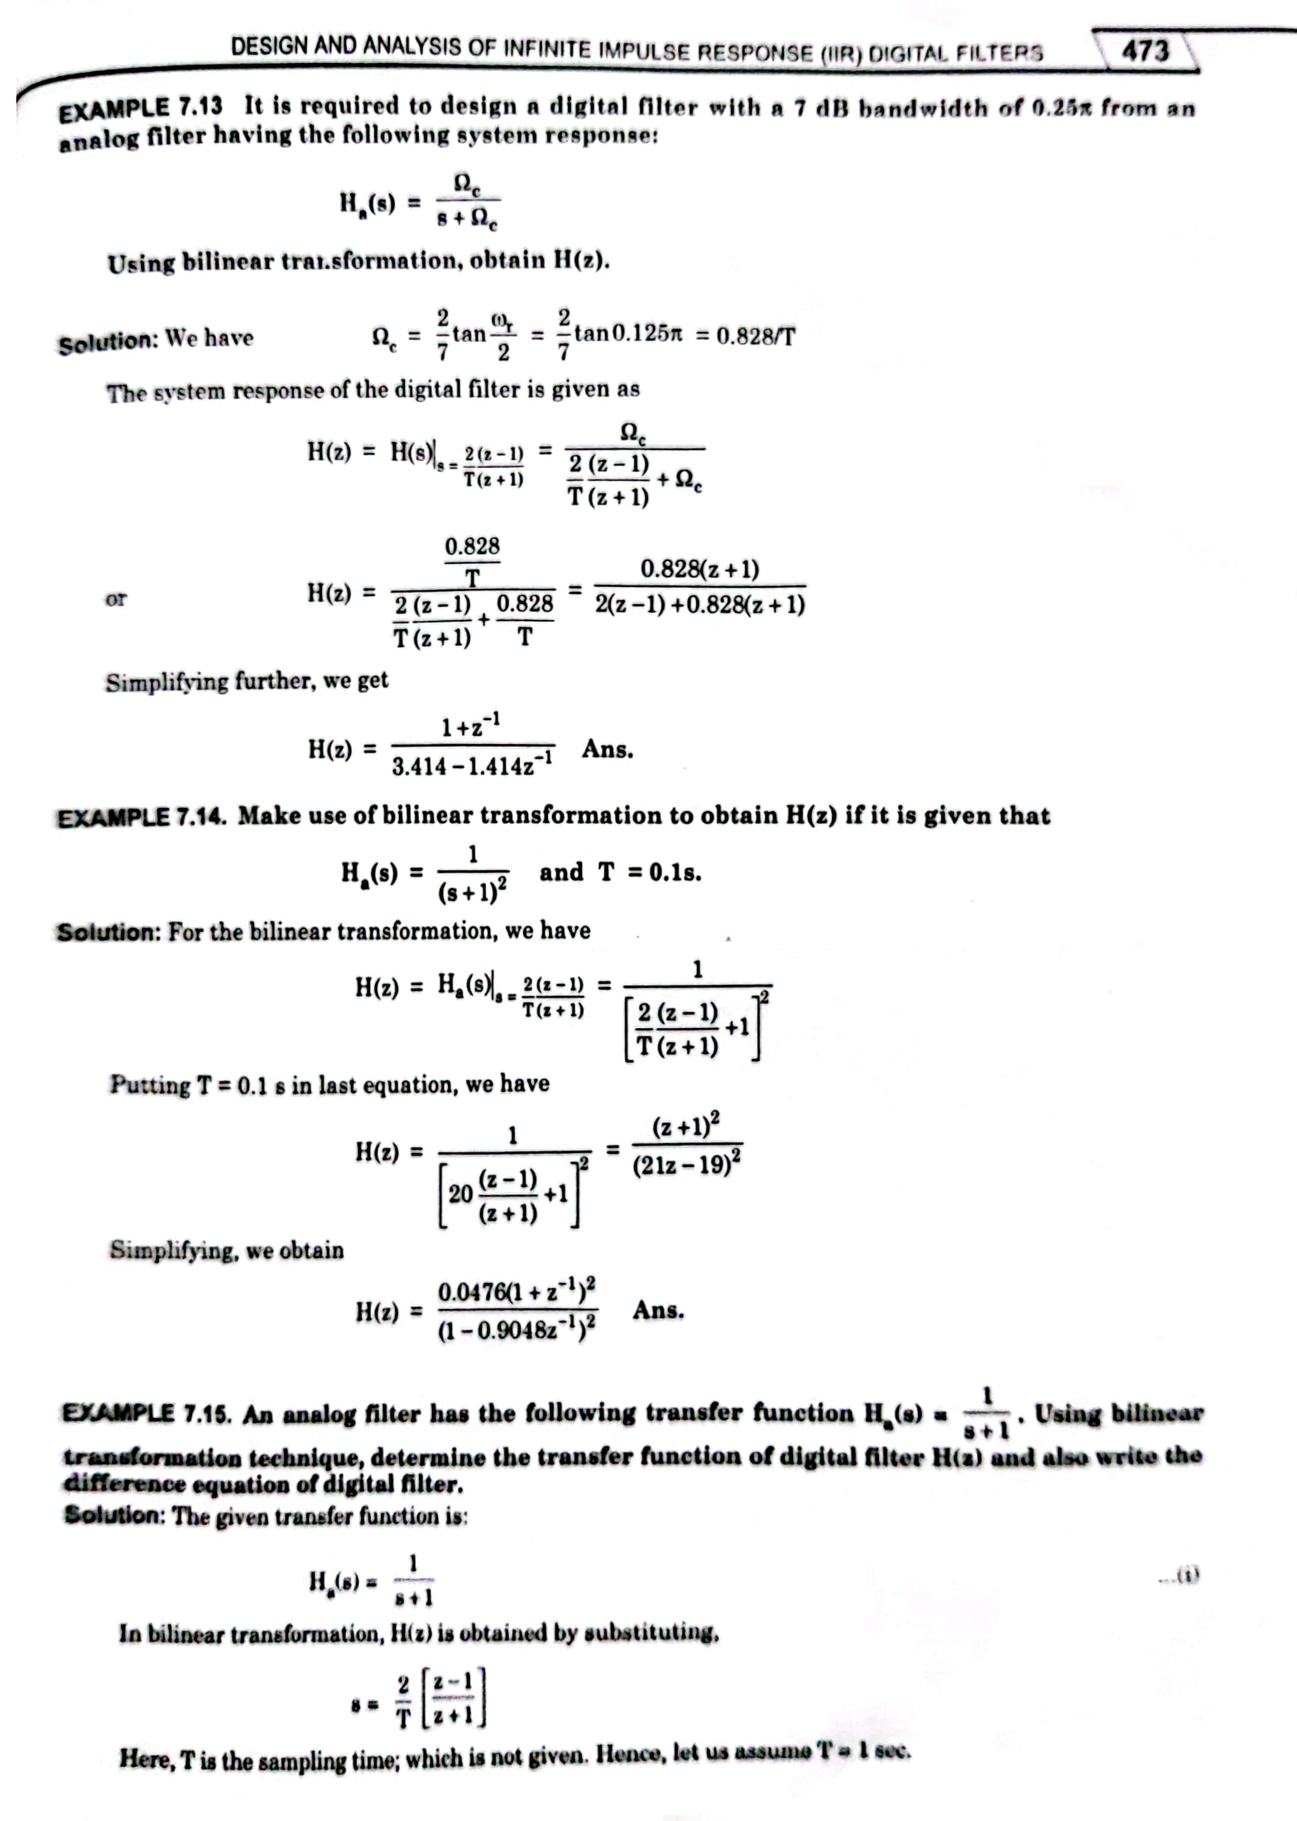

Slide 39
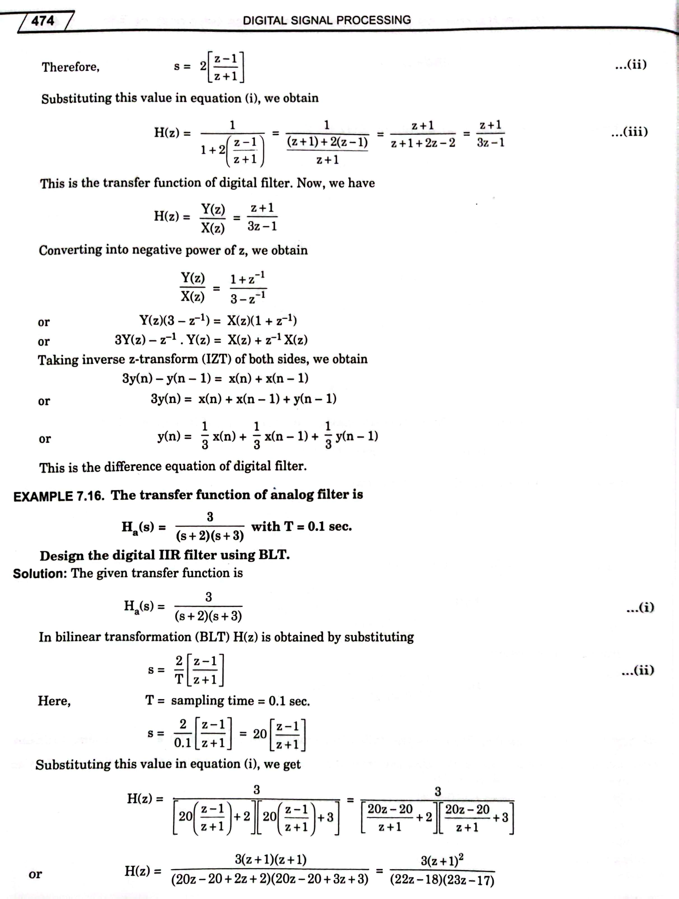

Slide 40
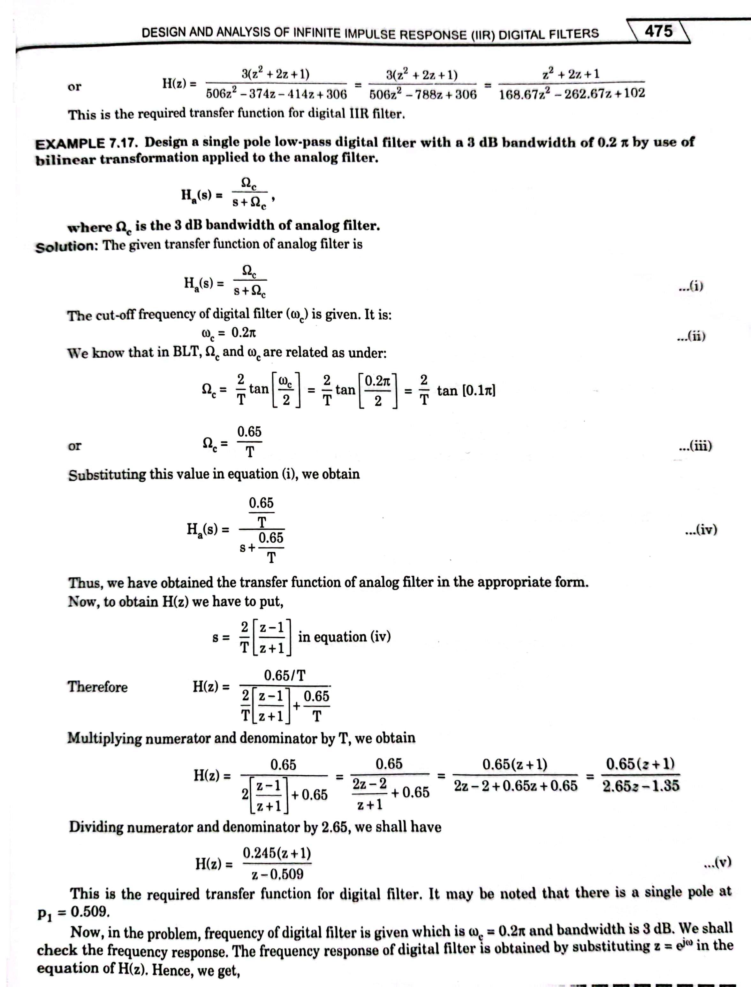

Slide 41
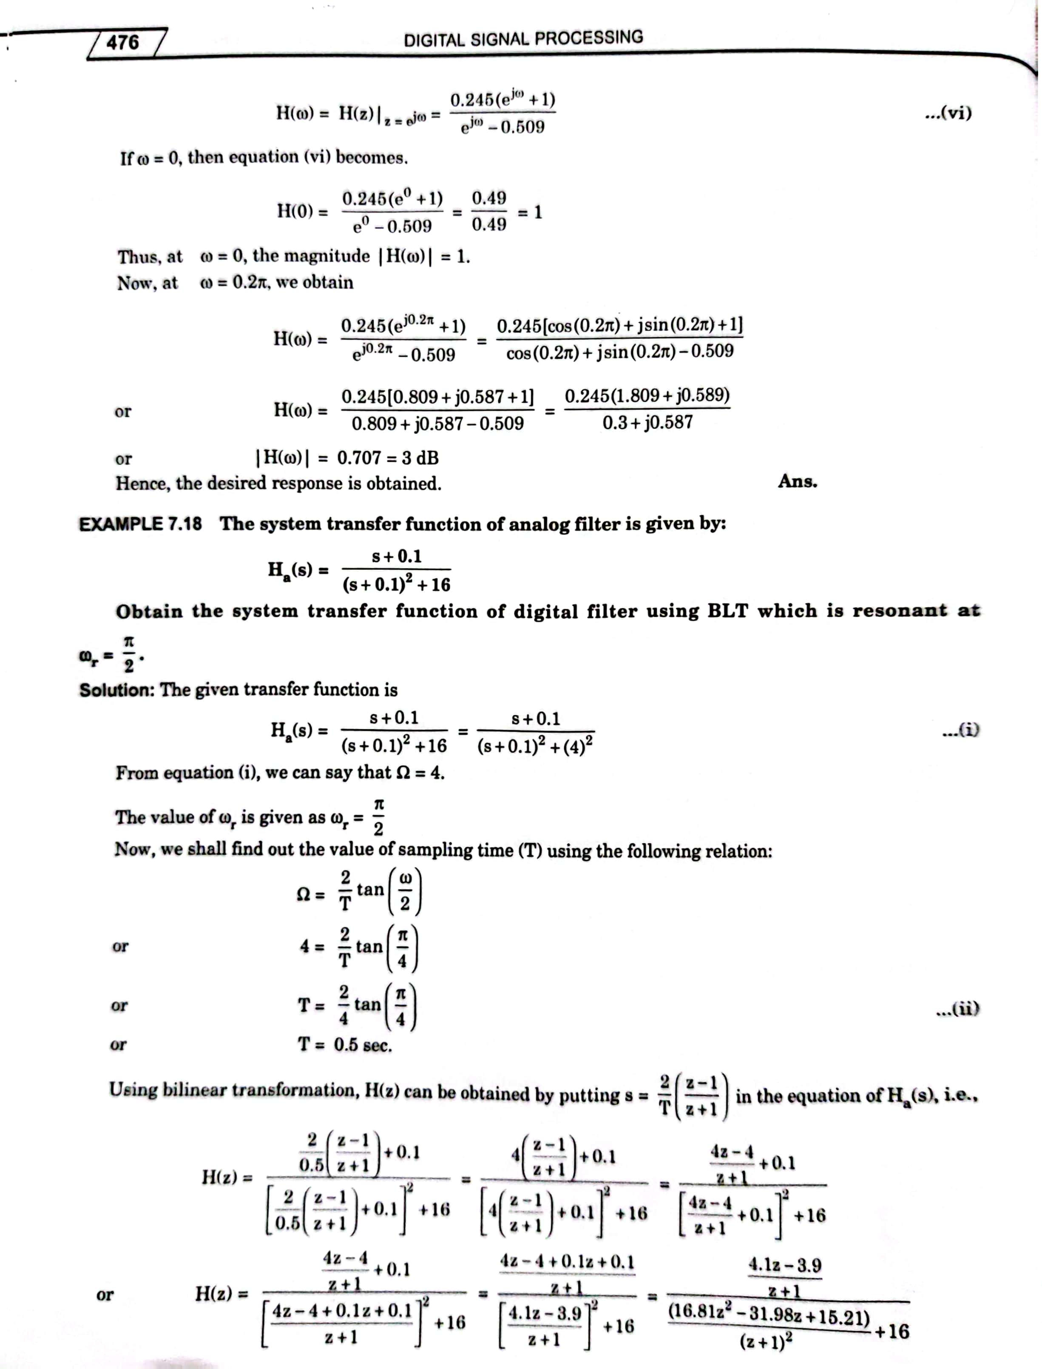

Slide 42
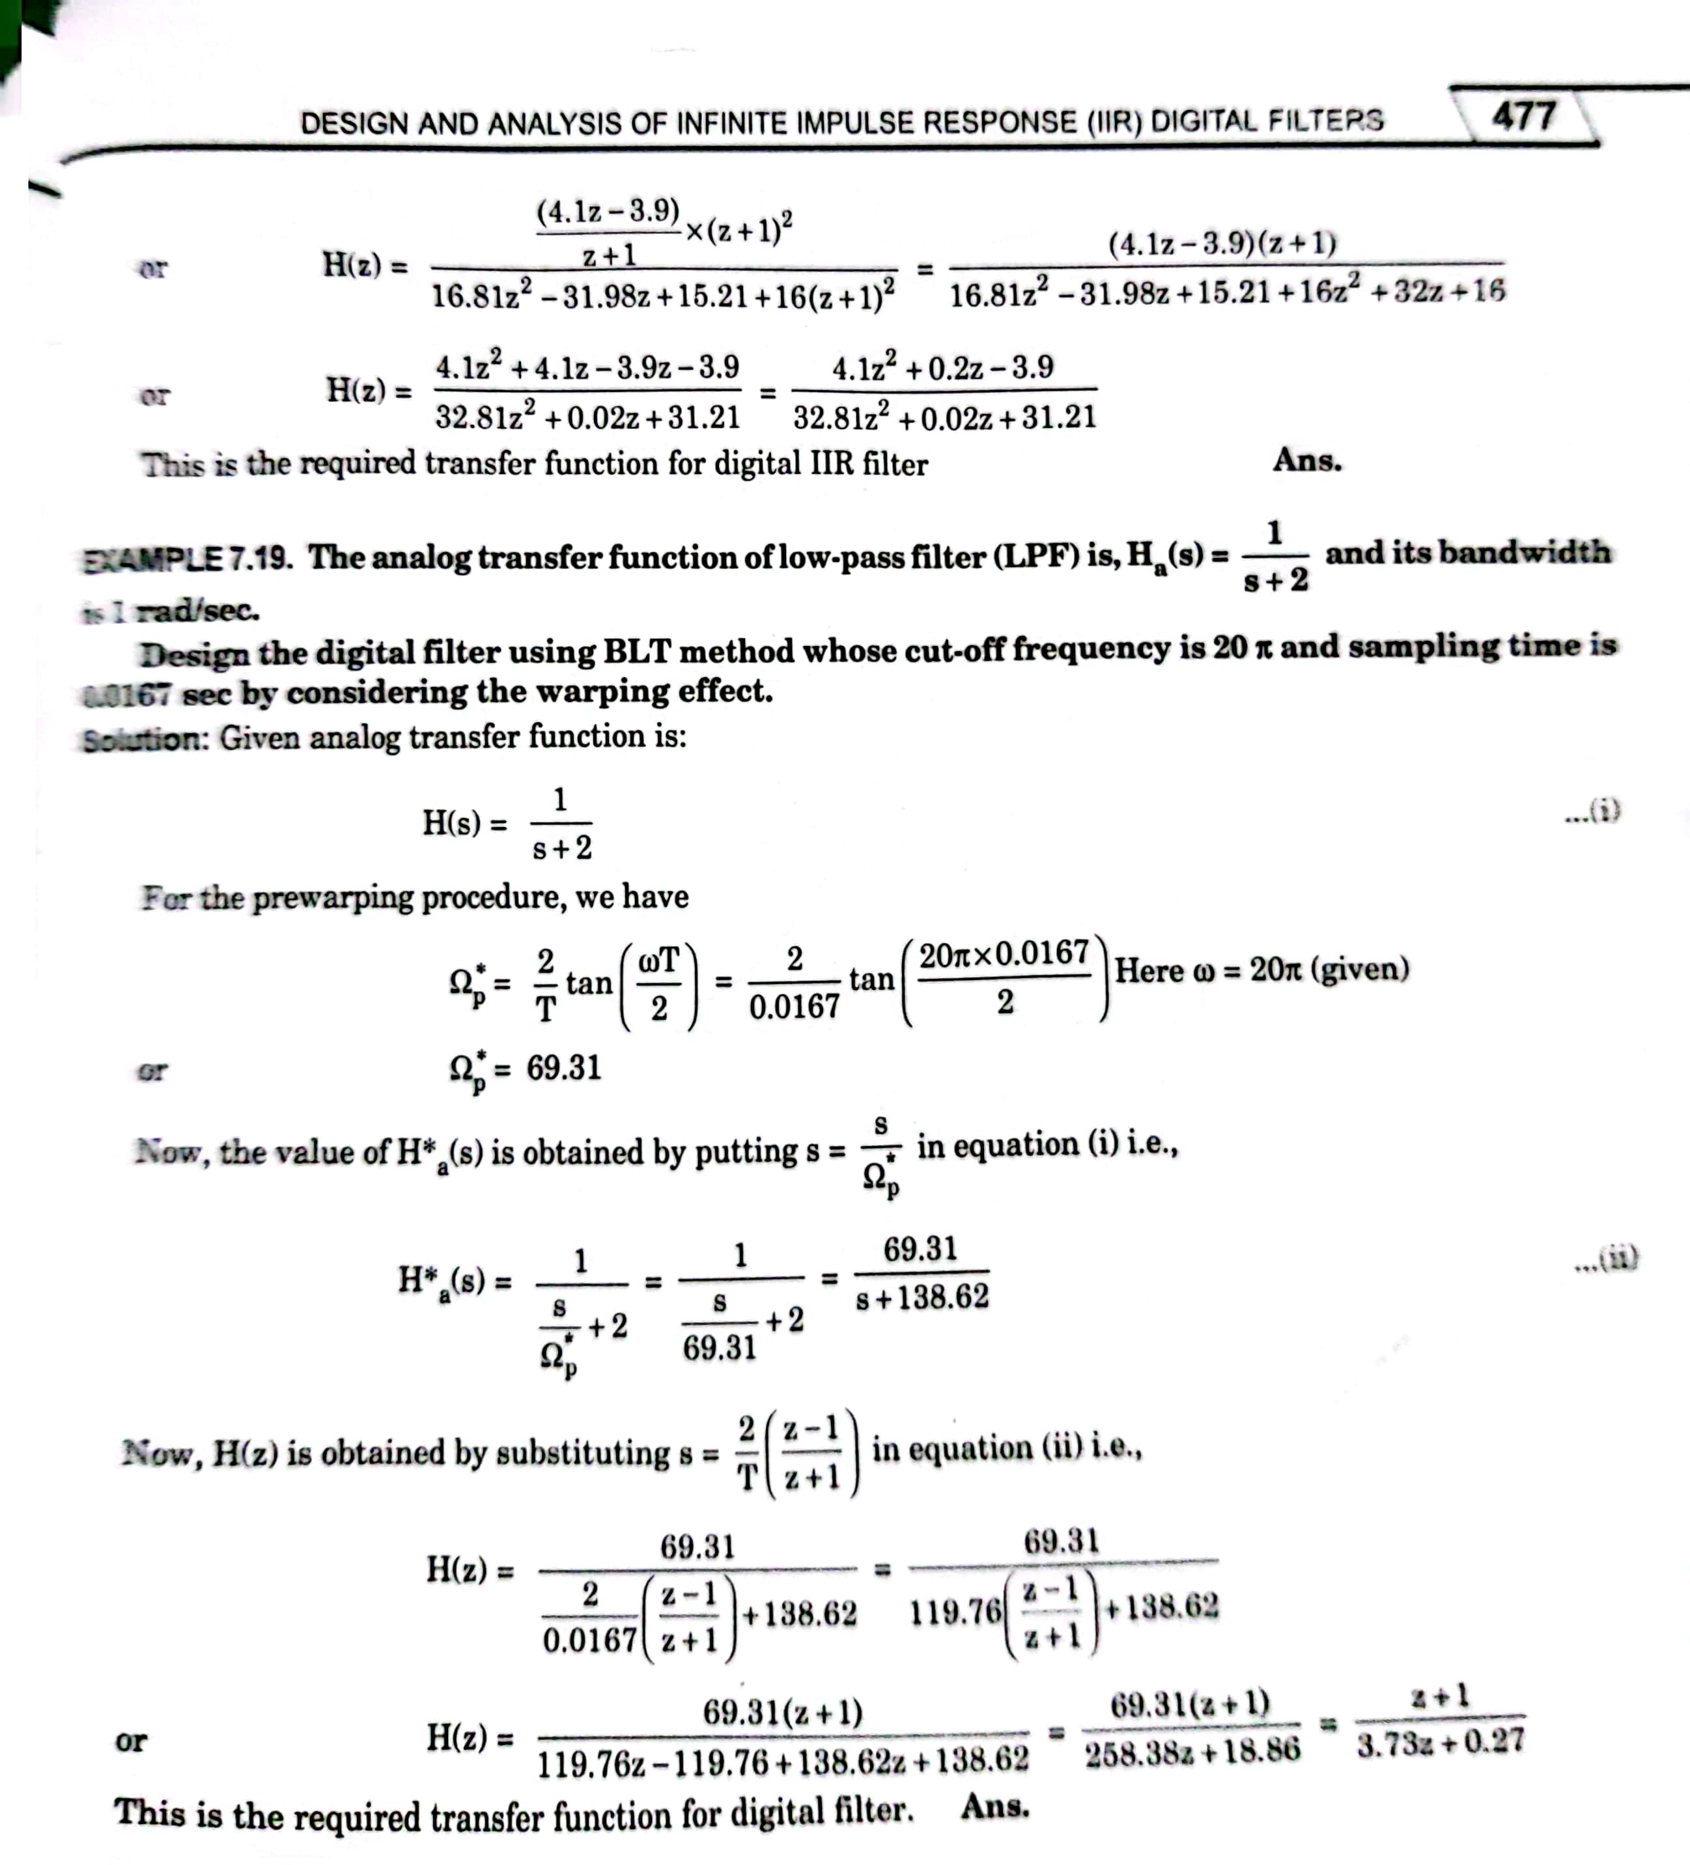

Slide 43
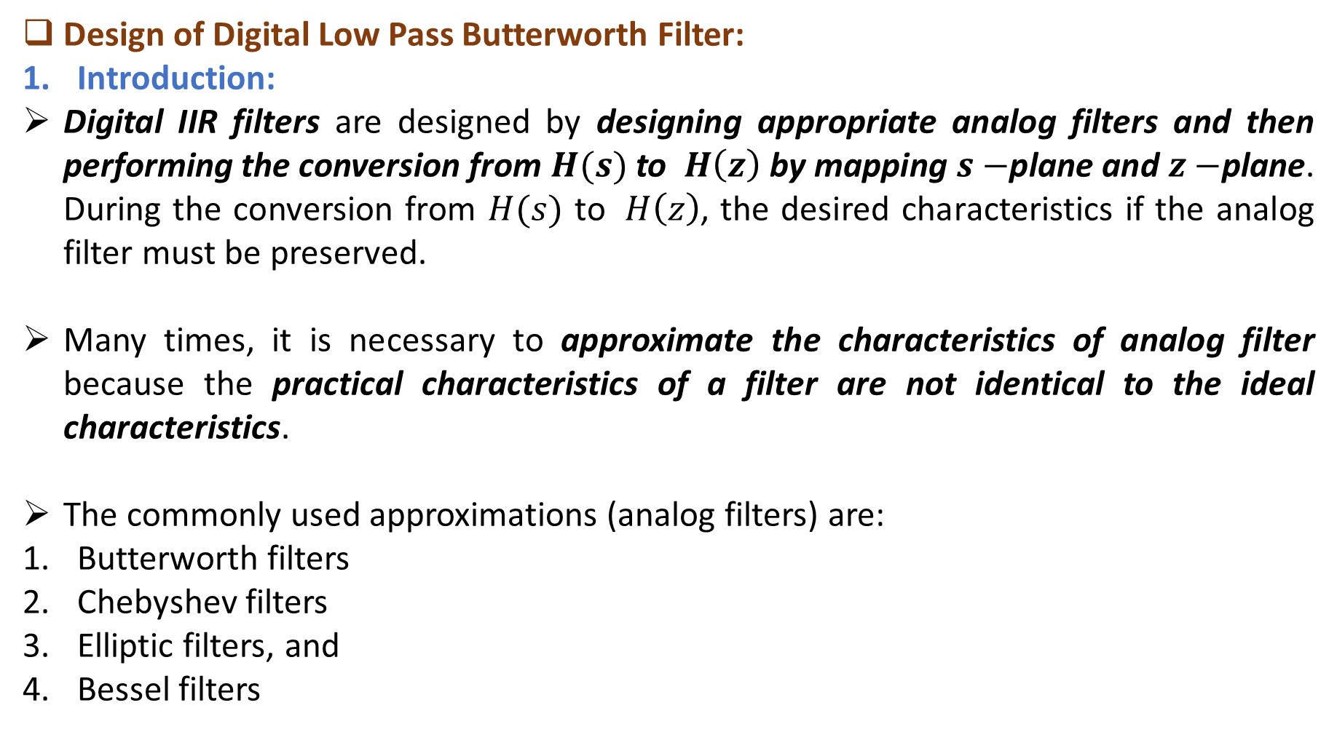
Design of Digital Low Pass Butterworth Filter:
Introduction:
Digital IIR filters are designed by designing appropriate analog filters and then performing the conversion from$H(s)$ to $H\left(z\right)$ by mapping $s−$plane and $z−$plane. During the conversion from $H(s)$ to $H\left(z\right)$, the desired characteristics if the analog filter must be preserved.
Many times, it is necessary to approximate the characteristics of analog filter because the practical characteristics of a filter are not identical to the ideal characteristics.
The commonly used approximations (analog filters) are:
Butterworth filters
Chebyshev filters
Elliptic filters, and
Bessel filters

Slide 44
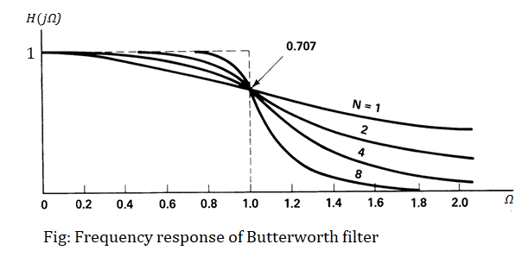
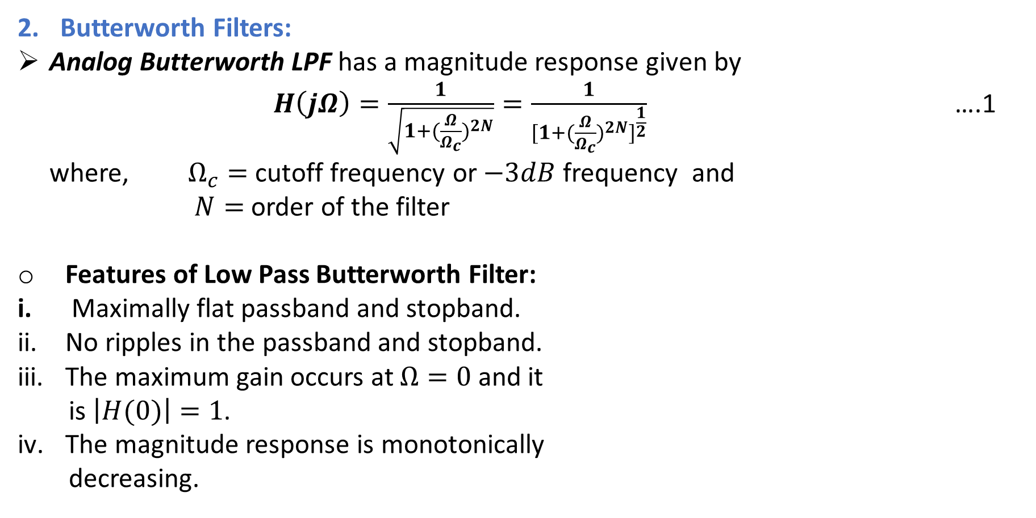
Butterworth Filters:
Analog Butterworth LPF has a magnitude response given by
$H\left(jΩ\right)=\frac{1}{\sqrt{1+{(\frac{Ω}{Ω_{c}})}^{2N}}}=\frac{1}{{[1+{(\frac{Ω}{Ω_{c}})}^{2N}]}^{\frac{1}{2}}}$ ….1
where, $Ω_{c}=$ cutoff frequency or $−3dB$ frequency and
$N=$ order of the filter
Features of Low Pass Butterworth Filter:
Maximally flat passband and stopband.
No ripples in the passband and stopband.
The maximum gain occurs at $Ω=0$ and it
is $\left|H(0)\right|=1$.
The magnitude response is monotonically
decreasing.

Slide 45

The design parameters of the analog (or continuous-time) Butterworth filter are obtained by considering the LPF with the desired specifications as given below:
$δ_{1}≤\left|H_{a}(jΩ)\right|≤1,$ $0≤Ω≤Ω_{p}$
$\left|H_{a}(jΩ)\right|≤δ_{2},$ $Ω_{s}≤Ω<∞$ …..2
The design parameters of the digital or (discrete-time) Butterworth filter are obtained by considering the LPF with the desired specifications as given below:
$δ_{1}≤\left| {H(e}^{jω})\right|≤1,$ $0≤ω≤ω_{p}$
$\left|{H(e}^{jω})\right|≤δ_{2},$ $ω_{s}≤ω≤π$ …..3
Note that ${H(e}^{jω})=H(ω)$.

Slide 46

Designing Expressions:
We know,
$δ_{1}≤\left|{H(e}^{jω})\right|≤1,$ $0≤ω≤ω_{p}$
$\left|{H(e}^{jω})\right|≤δ_{2},$ $ω_{s}≤ω≤π$ …..4
where, $δ_{1}=$ passband ripple
$δ_{2}=$ stopband ripple
$ω_{p}=$ passband edge frequency, and
$ω_{s}=$ stopband edge frequency
Order of the filter:
The corresponding analog magnitude response is to be obtained in the design process. Using equation(1) in (4), we obtain the order of filter as:
$N=\frac{1}{2} \{\frac{log⁡[(\frac{1}{δ_{2}^{2}}−1)/(\frac{1}{δ_{1}^{2}}−1)]}{log⁡(\frac{Ω_{s}}{Ω_{p}})}\}$
The value of $N$ is chosen to be the next higher nearest integer.

Slide 47

If $δ_{1}$ and $δ_{1}$ are given in $dB$, then the order of filter is
$N=\frac{1}{2}\{\frac{{(10}^{0.1δ_{2}dB} − 1)/{(10}^{0.1δ_{1}dB} − 1)}{log⁡(\frac{Ω_{s}}{Ω_{p}})}\}$
Cutoff Frequency:
The cutoff frequency of analog filter is given by the equation:
If digital filter’s cutoff frequency is given:
$Ω_{c}=$ $\frac{ω_{c}}{T}$ (For IIM) $Ω_{c}=\frac{2}{T}tan(\frac{ω_{c}}{2})$ (For BLT)
If digital filter’s cutoff frequency is not given:
$Ω_{c}=\frac{Ω_{p}}{{\left[\frac{1}{δ_{1}^{2}}−1\right]}^{\frac{1}{2N}}}$ In $dB$, $Ω_{c}=\frac{Ω_{p}}{{\left[{(10)}^{ 0.1δ_{1}} −1 \right]}^{\frac{1}{2N}}}$

Slide 48

Analog filter’s Edge Frequencies:
The values of analog filter’s edge frequencies $Ω_{p}$ and $Ω_{s}$ are obtained by using:
For BLT, $Ω=\frac{2}{T} tan(\frac{ω}{2})$
For IIM, $Ω=\frac{ω}{T}$
Poles of Butterworth Filter:
The poles of analog filters are obtained by the equation:
$P_{k}=Ω_{c}{e }^{\frac{j(2k+N+1)π}{2N}}$ , $k=0,1,2,…., N−1$

Slide 49

Transfer Function of Analog Filter:
The transfer function of analog filter is given by
$H\left(s\right)=\frac{Ω_{c}^{N}}{\left(s−P_{1}\right)\left(s−P_{2}\right)\left(s−P_{3}\right)……}$
Case:
If the poles are complex conjugate then
$H\left(s\right)=\frac{Ω_{c}^{N}}{\left(s−P_{1}\right)\left(s−P_{1}^{∗}\right)\left(s−P_{2}\right)\left(s−P_{2}^{∗}\right)……}$
System Function of Digital Filter:
Design of digital filter is the conversion of $H\left(s\right)$ into $H\left(z\right)$.

Slide 50

Precedence Design Steps:
Determination of the analog filter’s edge frequencies
For BLT, $Ω=\frac{2}{T} tan(\frac{ω}{2})$
For IIM, $Ω=\frac{ω}{T}$
Determination of the order of the filter, $N$
Determination of the cutoff frequency, $Ω_{c}$
Determination of the poles of $H(s)$
Determination of transfer function $H_{a}(s)$ or $H(s)$ of analog filter
Determination of digital filter, ( determination of $H\left(z\right)$)

Slide 51

Examples:
Design a Butterworth filter using IIM method to satisfy the following conditions (specifications)
$0.8≤\left| {H(e}^{jω})\right|≤1,$ $0≤ω≤0.2π$
$\left|{H(e}^{jω})\right|≤0.2,$ $0.6π≤ω≤π$
Solution:
Comparing given equation with the standard discrete-time Butterworth filter
$δ_{1}≤\left| {H(e}^{jω})\right|≤1,$ $0≤ω≤ω_{p}$
$\left|{H(e}^{jω})\right|≤δ_{2},$ $ω_{s}≤ω≤π$
we get,
passband attenuation, $δ_{1}=0.8$
stopband attenuation, $δ_{2}=0.2$
passband edge frequency,$ω_{p}=0.2π$ , and
stopband edge frequency,$ω_{s}=0.6π$
Since, sampling interval ($T$) is not given, assume $T=1$ sec.

Slide 52

Step-1: Determination of Analog Filter’s Edge Frequencies
For IIM, $Ω=\frac{ω}{T}$
Passband edge frequency, $Ω_{p}=\frac{ω_{p}}{T}=\frac{0.2π}{1}=0.628$
Stopband edge frequency, $Ω_{s}=\frac{ω_{s}}{T}=\frac{0.6π}{1}=1.885$
Step-2: Determination of the Order of the Filter
The order of filter is given by
$N=\frac{1}{2} \{\frac{log⁡[(\frac{1}{δ_{2}^{2}}−1)/(\frac{1}{δ_{1}^{2}}−1)]}{log⁡(\frac{Ω_{s}}{Ω_{p}})}\}$
$N=\frac{1}{2} \left\{\frac{\log\left[\frac{\frac{1}{{0.2}^{2}}−1}{\frac{1}{{0.8}^{2}}−1}\right]}{\log\left(\frac{1.885}{0.628}\right)}\right\}=1.3$
Therefore, $N=2$

Slide 53

Step-3: Determination of the Cutoff Frequency, $Ω_{c}$
Since, $ω_{c}$ is not given we can calculate the $Ω_{c}$ using the expression
$Ω_{c}=\frac{Ω_{p}}{{\left[\frac{1}{δ_{1}^{2}}−1\right]}^{\frac{1}{2N}}}$ $=\frac{0.628}{{\left[\frac{1}{{0.8}^{2}}−1\right]}^{\frac{1}{2∗2}}}=0.725$
Step-4: Determination of Poles
Poles are given by the equation
$P_{k}=Ω_{c}{e }^{\frac{j(2k+N+1)π}{2N}}$ , $k=0,1,2,…., N−1$
Since, $N=2$ , $k=0,1$. Therefore,
$P_{k}=0.725 {e }^{\frac{j(2k+3)π}{4}}$ …..i
Now, $P_{0}=0.725 {e }^{\frac{j3π}{4}}=−0.51+j0.51$
$P_{1}=0.725 {e }^{\frac{j5π}{4}}=−0.51−j0.51$
We observe that, $P_{0}=P_{1}^{∗}$
Note that for stable filter we select poles from LHP of s-plane.

Slide 54

Step-5: Determination of $H_{a}\left(s\right)$
We know,
$H_{a}\left(s\right)=\frac{Ω_{c}^{N}}{\left(s−P_{0}\right)\left(s−P_{1}\right)}$
$=\frac{{0.725}^{2} }{\left(s−(−0.51+j0.51)\right)\left(s−(−0.51−j0.51)\right)}$
$H_{a}\left(s\right)=\frac{0.52 }{\left(s−(−0.51+j0.51)\right)\left(s−(−0.51−j0.51)\right)}$
Applying partial fraction expansion, we have
$$H_{a}\left(s\right)=\frac{0.52 }{\left(s−(−0.51+j0.51)\right)\left(s−(−0.51−j0.51)\right)}$$
$=\frac{A_{1}}{\left(s−(−0.51+j0.51)\right)}+\frac{A_{2}}{\left(s−(−0.51−j0.51)\right)}$

Slide 55

Now, $A_{1}={\left.\left(s−(−0.51+j0.51\right)H_{a}\left(s\right)\right|}_{s=−0.51+j0.51}$
$={\left.\left(s−(−0.51+j0.51\right)\frac{0.52}{\left(s−(−0.51+j0.51\right)\left(s−(−0.51−j0.51\right)}\right|}_{s=−0.51+j0.51}$
Therefore, $A_{1}=j0.51$
Again, $A_{2}={\left.\left(s−(−0.51−j0.51\right)H_{a}\left(s\right)\right|}_{s=−0.51−j0.51}$
$={\left.\left(s−(−0.51−j0.51\right)\frac{0.52}{\left(s−(−0.51+j0.51\right)\left(s−(−0.51−j0.51\right)}\right|}_{s=−0.51−j0.51}$
Therefore, $A_{2}=−j0.51$
Thus, $H_{a}\left(s\right)=\frac{j0.51}{\left(s−(−0.51+j0.51)\right)}−\frac{j0.51}{\left(s−(−0.51−j0.51)\right)}$

Slide 56

Step-6: Determination of $H\left(z\right)$
For IIM, we know
$H_{a}\left(s\right)=\frac{C_{k}}{S±P_{k}}$ $H\left(z\right)=\frac{C_{k}}{1−e^{∓P_{k}T}z^{−1}}$
But, $T=1$ sec
Therefore,
$H\left(z\right)=\frac{j0.51}{1−e^{−0.51+j0.51}z^{−1}}−\frac{j0.51}{1−e^{−0.51−j0.51}z^{−1}}$
(simplify yourself)

Slide 57

Examples:
Design a Butterworth filter using BLT method to satisfy the following conditions (specifications)
$0.8≤\left|{H(e}^{jω})\right|≤1,$ $0≤ω≤0.2π$
$\left|{H(e}^{jω})\right|≤0.2,$ $0.6π≤ω≤π$
Solution:
Comparing given equation with the standard discrete-time Butterworth filter
$δ_{1}≤\left| {H(e}^{jω})\right|≤1,$ $0≤ω≤ω_{p}$
$\left|{H(e}^{jω})\right|≤δ_{2},$ $ω_{s}≤ω≤π$
we get,
passband attenuation, $δ_{1}=0.8$
stopband attenuation, $δ_{2}=0.2$
passband edge frequency,$ω_{p}=0.2π$ , and
stopband edge frequency,$ω_{s}=0.6π$
Since, sampling interval ($T$) is not given, assume $T=1$ sec.

Slide 58

Step-1: Determination of Analog Filter’s Edge Frequencies
For BLT, $Ω=\frac{2}{T} tan(\frac{ω}{2})$
Passband edge frequency, $Ω_{p}=\frac{2}{T} tan\left(\frac{ω_{p}}{2}\right)=\frac{2}{1} tan\left(\frac{0.2π}{2}\right)=0.65 rad/sec$
Stopband edge frequency, $Ω_{s}=\frac{2}{T} tan\left(\frac{ω_{s}}{2}\right)=\frac{2}{1} tan\left(\frac{0.6π}{2}\right)=2.75 rad/sec$
Step-2: Determination of the Order of the Filter
The order of filter is given by
$N=\frac{1}{2} \{\frac{log⁡[(\frac{1}{δ_{2}^{2}}−1)/(\frac{1}{δ_{1}^{2}}−1)]}{log⁡(\frac{Ω_{s}}{Ω_{p}})}\}$
$N=\frac{1}{2} \left\{\frac{\log\left[\frac{\frac{1}{{0.2}^{2}}−1}{\frac{1}{{0.8}^{2}}−1}\right]}{\log\left(\frac{1.885}{0.628}\right)}\right\}=1.3$
Therefore, $N=2$

Slide 59

Step-3: Determination of the Cutoff Frequency, $Ω_{c}$
Since, $ω_{p}$ is not given we can calculate the $Ω_{c}$ using the expression
$Ω_{c}=\frac{Ω_{p}}{{\left[\frac{1}{δ_{1}^{2}}−1\right]}^{\frac{1}{2N}}}$ $=\frac{0.65}{{\left[\frac{1}{{0.8}^{2}}−1\right]}^{\frac{1}{2∗2}}}=0.75$
Step-4: Determination of Poles
Poles are given by the equation
$P_{k}=Ω_{c}{e }^{\frac{j(2k+N+1)π}{2N}}$ , $k=0,1,2,…., N−1$
Since, $N=2$ , $k=0,1$. Therefore,
$P_{k}=0.75 {e }^{\frac{j(2k+3)π}{4}}$ …..i
Now, $P_{0}=0.725 {e }^{\frac{j3π}{4}}=−0.53+j0.53$
$P_{1}=0.725 {e }^{\frac{j5π}{4}}=−0.53−j0.5$3
We observe that, $P_{0}=P_{1}^{∗}$
Note that for stable filter we select poles from LHP of s-plane.

Slide 60

Step-5: Determination of $H_{a}\left(s\right)$
We know,
$H_{a}\left(s\right)=\frac{Ω_{c}^{N}}{\left(s−P_{0}\right)\left(s−P_{1}\right)}$
$=\frac{{0.75}^{2} }{\left(s−(−0.53+j0.53)\right)\left(s−(−0.53−j0.53)\right)}$
$=\frac{0.56 }{(\left(s+0.53)−j0.53\right)(\left(s+0.53)+j0.53\right)}$
$=\frac{0.56 }{{(s+0.53)}^{2}+{0.53}^{2}}$
$=\frac{0.56 }{s^{2}+1.06s+0.56}$
Therefore, $H_{a}\left(s\right)=\frac{0.56 }{s^{2}+1.06s+0.56}$

Slide 61

Step-6: Determination of $H\left(z\right)$
For BLT, we know
$H\left(z\right)={\left.H_{a}(s)\right|}_{s=\frac{2}{T}(\frac{z−1}{z+1})}$
Assume, $T=1$ sec
Then , $H\left(z\right)= \frac{0.56 }{{(2(\frac{z−1}{z+1}))}^{2}+1.06(2(\frac{z−1}{z+1}))+0.56}$
$H\left(z\right)= \frac{0.56 }{{(2(\frac{z−1}{z+1}))}^{2}+2.12 (\frac{z−1}{z+1}) +0.56}$
$=\frac{0.56{(z+1)}^{2}}{4{(z−1)}^{2}+2.12{(z}^{2}−1)+0.56{(z+1)}^{2}}$
$=\frac{0.56{(z+1)}^{2}}{4z^{2}−8z+4+2.12z^{2} −2.12+0.56z^{2}+1.12z+0.56}$

Slide 62

Or, $H\left(z\right)=\frac{0.56{(z+1)}^{2}}{6.68z^{2}−6.88z+2.44}$
$H\left(z\right)=\frac{0.56{(z+1)}^{2}}{6.68(z^{2}−1.03z+0.36)}$
Therefore, $H\left(z\right)=\frac{0.084{(1+z^{−1})}^{2}}{1−1.03z^{−1}+0.36z^{−2}}$

Slide 63
Properties of Chebyshev Filter, Properties of Elliptic Filters, Properties of Bessel Filters, Spectral Transformations:
Chebyshev Filters:
There are two types of Chebyshev filters:
Type I Chebyshev Filters
Type II Chebyshev Filters (Or, Inverse Chebyshev Filters)
Chebyshev filters are studied as explained below:
Type-I Chebyshev Filters:
Introduction:
These are simply called Chebyshev filters. These filters are all pole filters that exhibit equiripple behavior in passband and monotonic behavior in stopband.

Slide 64

The magnitude squared frequency response characteristic is given by
${\left|H(Ω)\right|}^{2}=\frac{1}{1+ε^{2} {T_{N}}^{2} (\frac{Ω}{Ω_{p}})}$ …..1
where, $ε=$ passband ripple parameter
$T_{N}\left(x\right)=$ Chebyshev polynomial of order $N$ defined as
$T_{N}\left(x\right)=\left\{\begin{aligned}\cos\left(N\cos^{−1}\left(x\right)\right), \left|x\right|≤1 \\ \cosh\left(N\cosh^{−1}\left(x\right)\right), \left|x\right|>1\end{aligned}\right.$
The Chebyshev polynomial can be generated by the recursive equation
$T_{N}\left(x\right)=2x T_{N}\left(x\right)−T_{N−1}\left(x\right)$, $N=1,2,…$
where, $T_{N}\left(x\right)=0$ and $T_{1}\left(x\right)=x$

Slide 65


Fig: Type I Chebyshev filter characteristic for $N−$odd and $N−$even
Properties of Chebyshev Polynomials:
$\left|T_{N}\left(x\right)\right|≤1$ for all $\left|x\right|≤1.$
$T_{N}\left(1\right)=1$ for all $N.$
All the roots of the polynomial $T_{N}\left(x\right)$ occur in the interval $−1≤x ≤1$.
For $N−$odd, $T_{N}\left(0\right)=0$ and hence ${\left|H(0)\right|}^{2}=1$.
For $N−$even, $T_{N}\left(0\right)=1$ and hence ${\left|H(0)\right|}^{2}=\frac{1}{1+ε^{2}}$.

Slide 66

Design Parameters (Specifications):
The design parameters of Chebyshev filter are obtained by considering the discrete-time LPF with the desired specifications as given
$δ_{1}≤\left|H\left(e^{jω}\right)\right|≤1 , 0≤ω≤ω_{p}$
$\left|H\left(e^{jω}\right)\right|≤δ_{2}, ω_{s}≤ω≤π$ …..2
The corresponding analog magnitude response is to be obtained in the design process. Using equation (1) in equation (2), we get
$δ_{1}^{2}≤\frac{1}{1+ε^{2} {T_{N}}^{2} \left(\frac{Ω}{Ω_{p}}\right)}≤1, 0≤Ω≤Ω_{p}$
$\frac{1}{1+ε^{2} {T_{N}}^{2} \left(\frac{Ω}{Ω_{p}}\right)}≤δ_{2}^{2}, Ω_{s}≤Ω≤π$ …..3

Slide 67

Ripple in the Passband ($ε$):
It is given by the equation, $ε={\{\frac{1}{δ_{1}^{2}}−1\}}^{\frac{1}{2}}$
In dB, we can write,
$ε={[{10}^{0.1δ_{1}}−1]}^{\frac{1}{2}}$
Order of the Filter:
When magnitude is expressed in dB, the order of the filter is given by
$\left|H\left(e^{jω}\right)\right|dB=−20\log_{10}ε−6\left(N−1\right)−2oN\log_{10}(ω_{s})$
It is also given by the equation
$N=\frac{\cosh^{−1}\{ \frac{1}{ε}({\frac{1}{δ_{2}^{2}}−1)}^{\frac{1}{2}} \}}{\cosh^{−1}(\frac{Ω_{s}}{Ω_{p}})}$

Slide 68

Poles of Chebyshev Type-I Filters:
Consider the poles locations of Butterworth filter is determined using realtion
$φ_{k}=\frac{π}{2}+\frac{(2k+1)π}{2N}$ , $k=0,1,2,…N−1$
The positions of poles of Chebyshev filter lie on ellipse at coordinates $(x_{k},y_{k})$, $k=0,1,2,…,N−1,$where,
$x_{k}=r_{2}cosφ_{k}$ and $y_{k}=r_{1}sinφ_{k}$
where, $r_{2}=Ω_{p}\frac{β^{2}+1}{2β}$, is the major axis, and
$r_{1}=Ω_{p} \frac{β^{2}−1}{2β}$ , is the minor axis
Here, $β$ is related to $ε$ according to equation
$β={[\frac{\sqrt{1+ε^{2}}+1}{ε}]}^{\frac{1}{N}}$

Slide 69

Then the poles are given by
$s_{k}=r_{2}cosφ_{k}+j r_{1}sinφ_{k}$
Analog Filter’s Edge Frequencies:
The values of analog filter’s edge frequencies are determined by the equation
$Ω=\frac{2}{T} tan⁡(\frac{ω}{2})$, for BLT $Ω=(ω$/$T)$, for IIM
Transfer function of Analog Filter:
It is given by the equation
$H\left(s\right)=\frac{i}{\left(s−s_{0}\right)\left(s−s_{1}\right)\left(s−s_{2}\right)…}$
After simplification , we get
$H\left(s\right)=\frac{i}{s^{N}+b_{N−1}s^{N−1}+…+b_{0}}$
where, $b_{0}=$ constant term in denominator

Slide 70

and, $i=\left\{\begin{aligned}b_{0}, N odd \\ \frac{b_{0}}{\sqrt{1+ε^{2}}}, N even\end{aligned}\right.$
System Function of Digital Filter:
Finally, digital filter is designed by converting $H(s)$ into $H(z)$ using
BLT , and
IIM
Precedence Steps:
Determination of analog filter’s edge frequencies
Determination of the order of the filter
Determination of poles
Determination of $H(s)$
Determination of $H(z)$

Slide 71

Example: Design a digital LPF using Chebyshev filter to meet the following specifications:
Passband magnitude characteristic is constant within 1 dB for recurrences below $ω=0.2π$, and
Stopband attenuation of at least 15dB for frequencies below $ω=0.2π$ and $π.$
Solution:

Slide 72

Type-II Chebyshev Filters:
These filters contains poles as well as zeros that exhibit monotonic behavior in passband and equiripple behavior in stopband, just opposite of that of Chebyshev type-I filters. Therefore, these filters are also called Inverse Chebyshev filters

Slide 73


The magnitude squared frequency response of type-II Chebyshev filter is given by
where, $T_{N}\left(x\right)=$ Chebyshev polynomial of order $N$

Slide 74



Elliptic Filters:
Elliptic filters are also called Cauer filters. These filters exhibit equiripple behavior in both the passband and the stopband.
$U_{N}\left(x\right)=$ Jacobian elliptic function of order N
$ε=$ passband ripple parameter
$Ω_{p}=$ passband edge ripple or attenuation
The zeros lie on the $j$Ω$−$axis.
This class of filters contains both poles and zeros and is characterized by the magnitude-squared frequency response
where,

Slide 75
FIR filters that the most efficient designs occur when we spread the approximation error equally over the passband and the stopband. Elliptic filters accomplish this objective and, are the most efficient because yielding the smallest-order filter for a given set of specifications.
Equivalently, we can say that for a given order and a given set of specifications, an elliptic filter has the smallest transition bandwidth.

Slide 76





Bessel Filters:
Bessel filters are a class of all-pole filters that are characterized by the system function
Where $B_{N}(s)$ is the $N^{th}order$ Bessel polynomial. These polynomials can be expressed in the form
where the coefficients $\{a_{k}\}$ are given as
Alternatively, the Bessel polynomials may be generated recursively from the relation
with $B_{0}\left(s\right)=1$ and $B_{1}\left(s\right)=s+1$ as initial conditions.

Slide 77



Slide 78

An important characteristic o f Bessel filters is the linear-phase response over the passband of the filter.
For example, fig above shows a comparison of the magnitude and phase responses o f a Bessel filter and Butterworth filter of order $N = 4$. We note that the Bessel filter has a larger transition bandwidth, but its phase is linear within the passband.
The linear-phase characteristics of the analog filter are destroyed in the process of converting the filter into the digital domain by means of the transformations described previously.

Slide 79

Spectral Transformations: (Assignment)

